Slide 1

LTPP University Presentation
Missouri University of Science and Technology
Thursday July 8, 2015
Engineering Research Lab
Rolla, MO
Gabe Cimini and Carlos Leal
Notes:
Opening slide – up as attendees enter the meeting room

Slide 2



Notes:
TITLE
Good morning everyone, and welcome to the

Federal Highway Administration’s (FHWA)

Long-Term Pavement Performance (LTPP) program meeting with the

Missouri University of Science and Technology
We have a meeting attendee list circulating around the room, if you could please fill it out when it get to you we would really appreciate it
We have also provided everyone with the agenda for todays meeting
PAUSE
 - NEXT SLIDE

Slide 3

Our Team
Notes:
INTRODUCTION
First off, please allow me to introduce our LTPP team here with you today
PAUSE
 - NEXT SLIDE

Slide 4

Gabe Cimini
PROJECT MANAGER
NORTH CENTRAL REGIONAL CONTRACTOR
Notes:
GABE CIMINI
From the North Central Regional Office of the LTPP program

Mr. Gabe Cimini – Gabe is the Project Manager for the North Central Region of the LTPP program
And has been working with the LTPP program since it’s inception!
Together with Jack they posses a deep knowledge and understanding about the LTPP program, that may not be rivaled
PAUSE
 - NEXT SLIDE

Slide 5
Carlos Leal
DATABASE MANAGER
NORTH CENTRAL REGIONAL CONTRACTOR
Notes:
CARLOS LEAL
And lastly, myself

Carlos Leal
I am also from the North Central Regional Office of the LTPP program
And I am the Database Manager
I have been with the LTPP program for five years now…so I still have much to learn from these two!
Now if we could go around the room quickly and everyone could introduce themselves
PAUSE
 - NEXT SLIDE

Slide 6
History & Overview
Notes:
HISTORY & OVERVIEW
For those who are not familiar with the LTPP program, or for those who may need a little refresher,
we’ll start off with a brief history and a general overview of the LTPP program
PAUSE
 - NEXT SLIDE

Slide 7
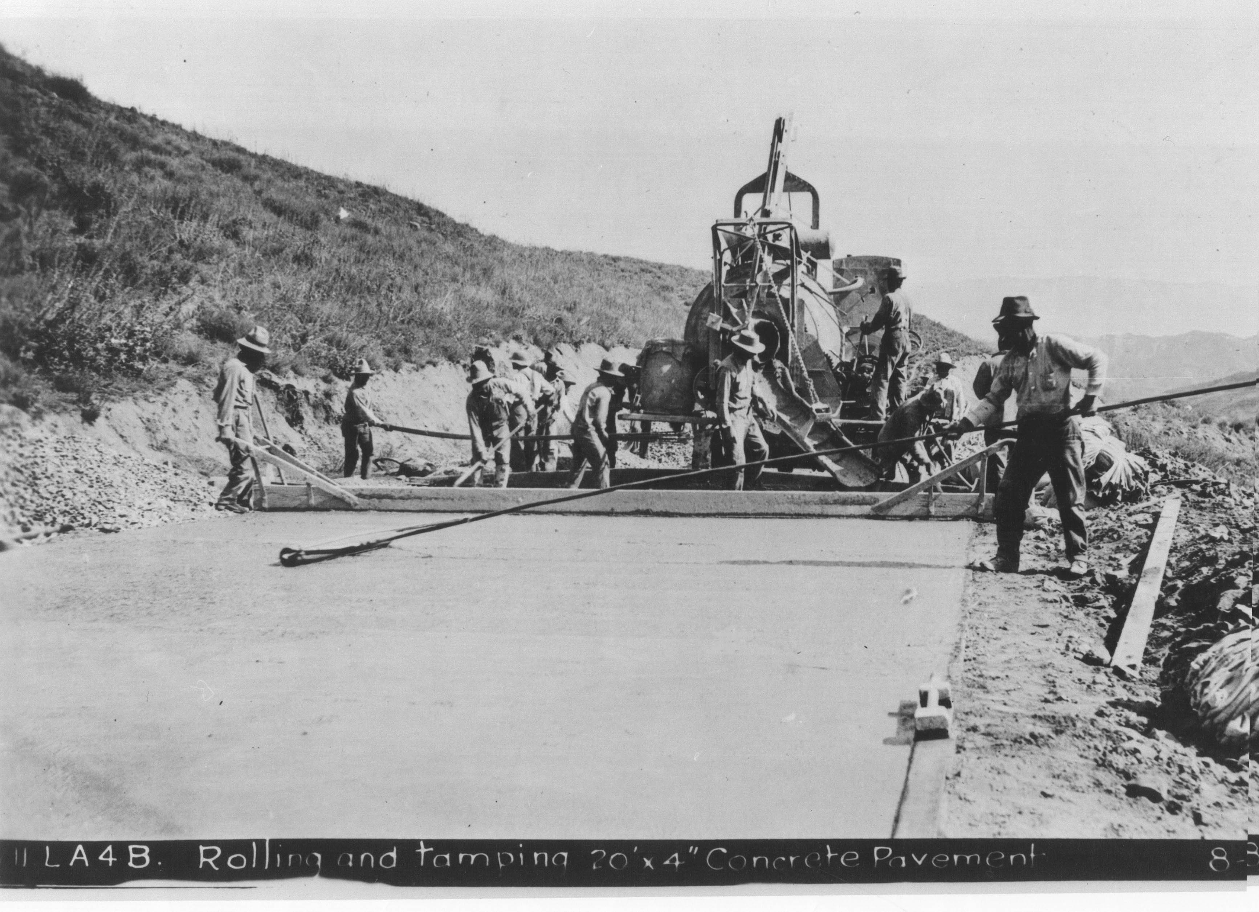
“
Long and Rich History…
History
Notes:
HISTORY
No, the LTPP program doesn’t date back to these guys, but since it is the longest running highway research program in history the LTPP program does have a

long and rich history
PAUSE
 - NEXT SLIDE

Slide 8


History
Largest Pavement Study EVER
Began in 1987
Establish Pavement Database
SHRP ➔ FHWA
SHA’s: 50 States, DC, PR, & 10 Provinces
Notes:
HISTORY - DETAILS

The Federal Highway Administration’s (FHWA) Long-Term Pavement Performance (LTPP) program is the largest pavement study EVER conducted

The LTPP program began in 1987 as part of the Strategic Highway Research Program (SHRP)

Its primary purpose was to establish a national long-term pavement database to support pavement research and improved pavement performance

When SHRP ended, as planned in 1992, the LTPP program continued under the Federal Highway Administration with the participation of

highway agencies in all 50 States, the District of Columbia, Puerto Rico, and the 10 Canadian Provinces
PAUSE
 - NEXT SLIDE

Slide 9
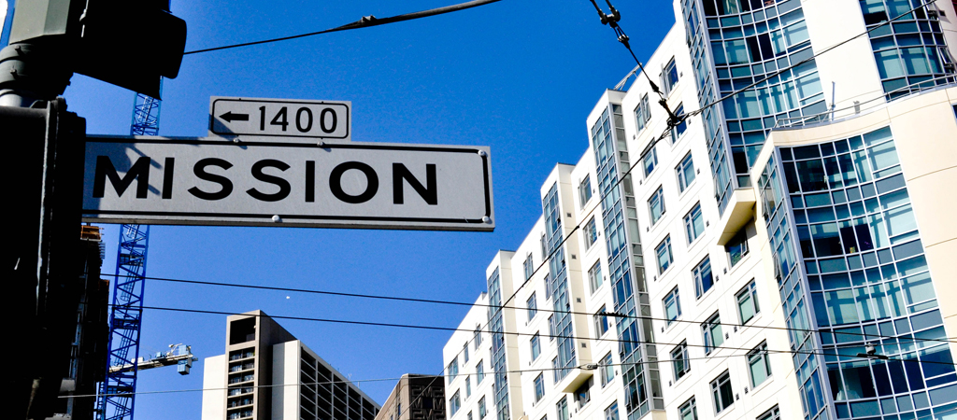
“
determine how and why pavements perform
Notes:
MISSION STATEMENT
The LTPP Mission Statement is:
Through the collection of in-service pavement performance related data and the analysis of those data,

determine how and why pavements perform in a particular manner, and develop and deliver products and tools to better design, construct, preserve, rehabilitate and manage pavements.
By collecting and analyzing data from LTPP pavement test sections over time, researchers are gaining insight on how and why pavements perform as they do—learning how to build better, longer lasting, more cost-effective pavements
PAUSE
 - NEXT SLIDE

Slide 10

“
estimated $2.5 billion in savings…
Notes:
SAVINGS
LTPP data has been utilized to provide over an

estimated $2 billion in savings, and as the program continues to monitor existing test sections and constructs NEW experiments, it provides

enormous potential for research and the development of products to further improve pavement technology for decades to come.
PAUSE
 - NEXT SLIDE

Slide 11
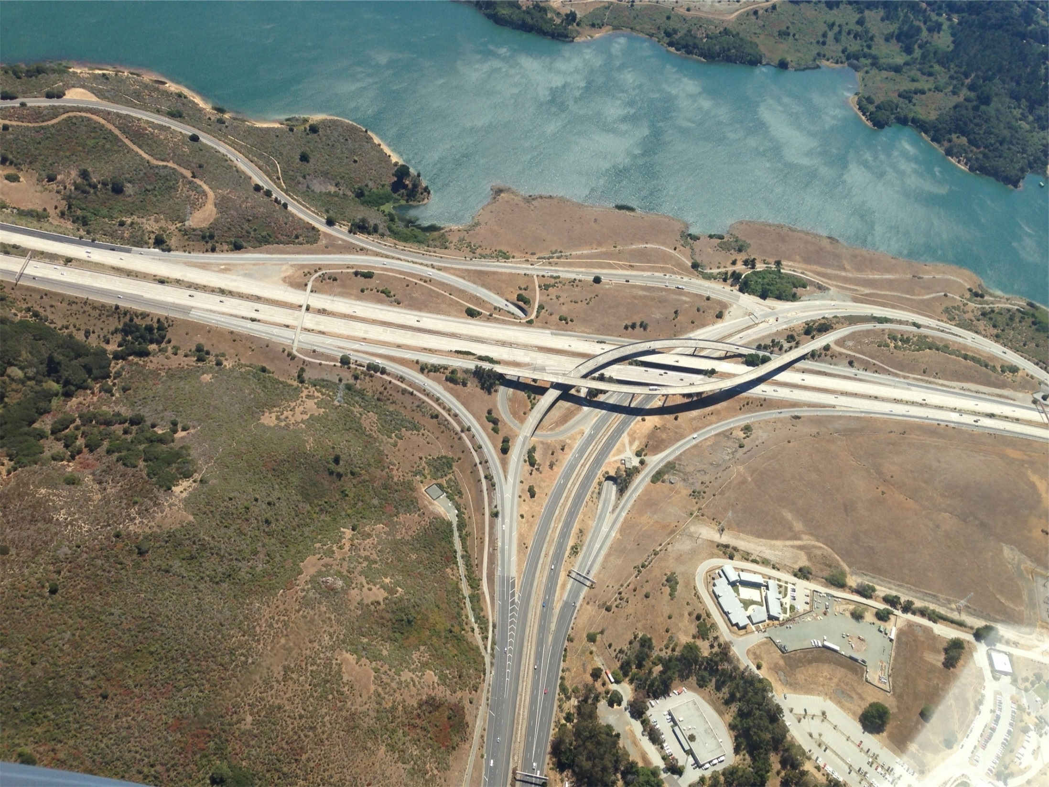
Overview
“
National Initiative
Notes:
OVERVIEW
The LTPP program is a

national initiative, and as you can probably imagine, it has a complex operational structure – So next we’ll provide a general overview of the program and it’s operations
PAUSE
 - NEXT SLIDE

Slide 12


LTPP Regions
4 Regions
North Central
15 SHA’s
Buffalo, NY
Notes:
LTPP REGIONS

There are 4 geographical regions in the LTPP program

FHWA has enlisted the services of regional contractors, like ourselves – Stantec, in each region to manage the regional operations

Missouri is in the North Central Region of the LTPP program

and is 1 of 15 state highway agencies in that region

The North Central Regional Office is located in Buffalo, NY
PAUSE
 - NEXT SLIDE

Slide 13
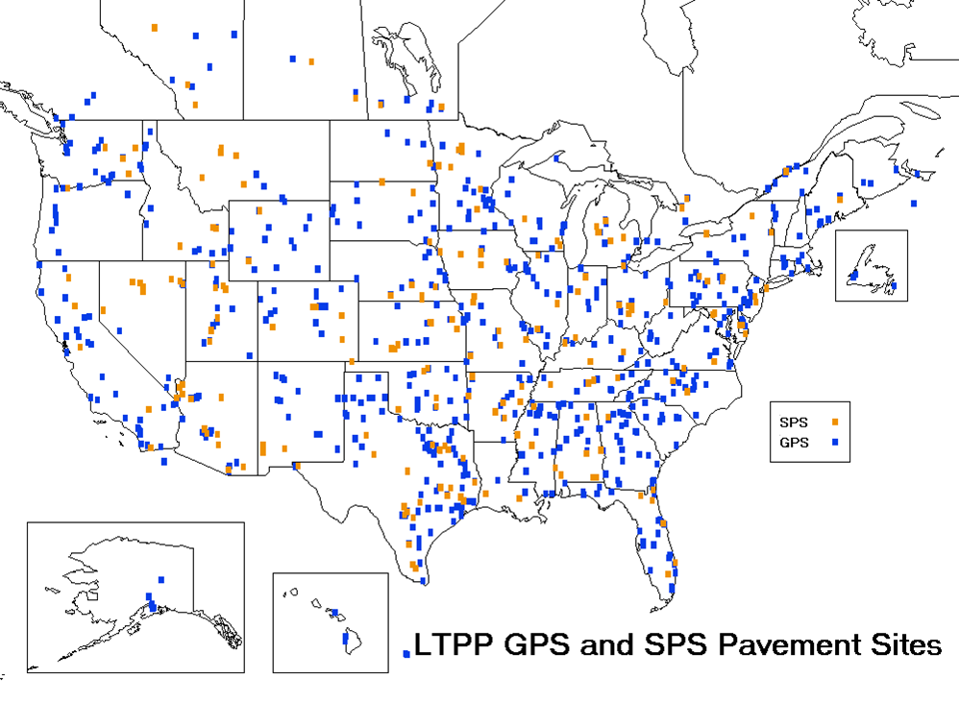
LTPP Test Sections
2,509 Total
In-Service Roads
USA & Canada
695 Active
NEW Experiments!
GPS – General Pavement Studies
SPS – Specific Pavement Studies
Notes:
LTPP TEST SECTIONS

Since 1989, the LTPP program has monitored a total of 2,509 LTPP test sections

on in-service pavements throughout the United States, Puerto Rico and Canada

695 test sections are still active and are still being continuously monitored

…and more being added with NEW LTPP Experiments being introduced into the program
PAUSE
 - NEXT SLIDE

Slide 14
General Pavement Studies (GPS)
GPS-1: Asphalt Concrete (AC) on Granular Base
GPS-2: AC on Bound Base
GPS-3: Jointed Plain Concrete Pavement
GPS-4: Jointed Reinforced Concrete Pavement
GPS-5: Continuously Reinforced Concrete Pavement
GPS-6: AC Overlay on AC Pavements
GPS-7: AC Overlay on Portland Cement Concrete (PCC)
GPS-8: Cancelled
GPS-9: Unbounded PCC Overlays on PCC Pavements
Notes:
GPS & SPS
List of LTPP Experiments
PAUSE
 - NEXT SLIDE

Slide 15
Specific Pavement Studies (SPS)
SPS-1: Strategic Study of Structural Factors for Flexible Pavements
SPS-2: Strategic Study of Structural Factors for Rigid Pavements
SPS-3: Preventative Maintenance Effective for Flexible Pavements
SPS-4: Preventative Maintenance Effective for Rigid Pavements
SPS-5: Rehabilitation of AC Pavements
SPS-6: Rehabilitation of Jointed PCC Pavements
SPS-7: Bonded PCC Overlays on Concrete Pavements
SPS-8: Study of Environmental Effects in the Absence of Heavy Loads
SPS-9: Validation of SHRP Asphalt Specification/Mix Design (Superpave)
SPS-10: Warm Mix Asphalt Overlay of Asphalt Pavement
Notes:
GPS & SPS
List of LTPP Experiments
PAUSE
 - NEXT SLIDE

Slide 16

Core Functions
Data Collection & Management
Data Analysis
Product Development
Communication
Notes:
CORE FUNCTIONS
The LTPP program has four CORE functions
They are:


Data Collection & Management

Data Analysis

Product Development

And Communication
PAUSE
 - NEXT SLIDE

Slide 17
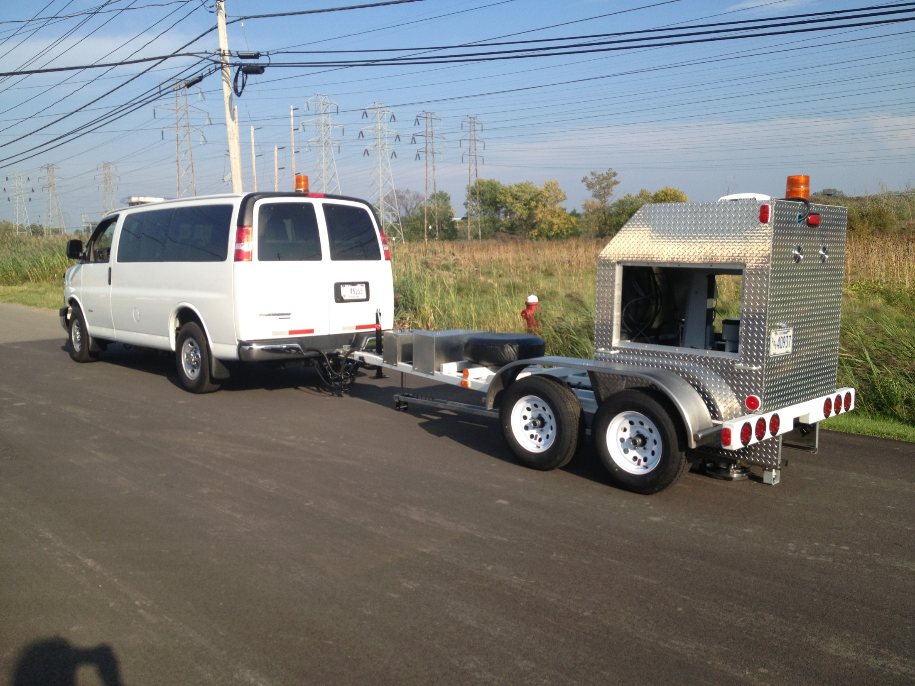
Collect
Store/Backup
Process
Provide Access
Data Collection & Management
Notes:
DATA COLLECTION & MANAGEMENT
Collecting and managing pavement performance data from a large number of in-service highways throughout North America, over an extended period, to support analysis and product development,
Data Collection & Management involves:


On-site collection of pavement data

In-office Processing of the raw data

Storing and Backup of all the data

and Providing Accessibility to the data
PAUSE
 - NEXT SLIDE

Slide 18
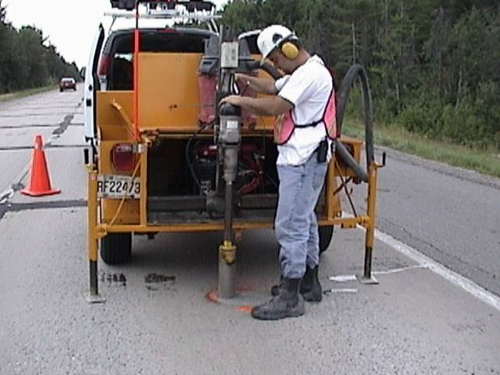
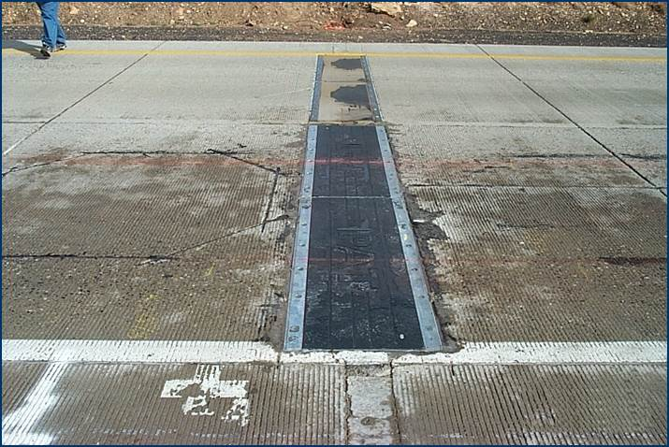
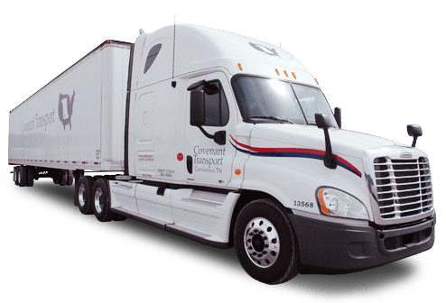

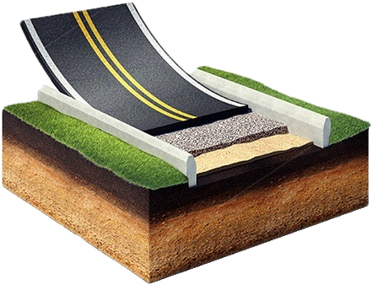

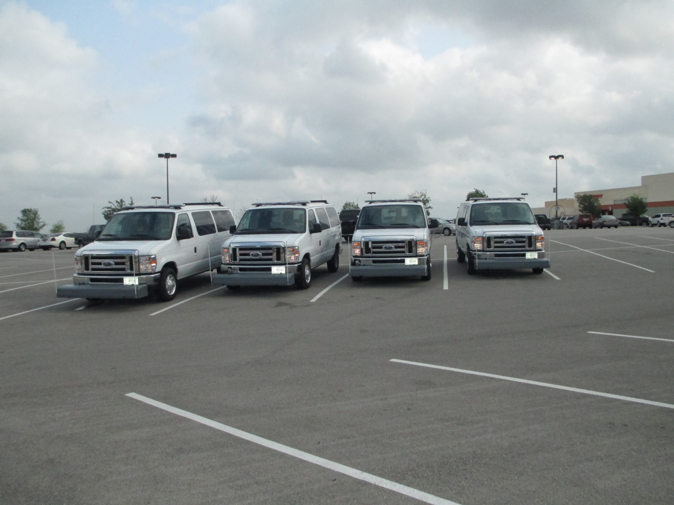
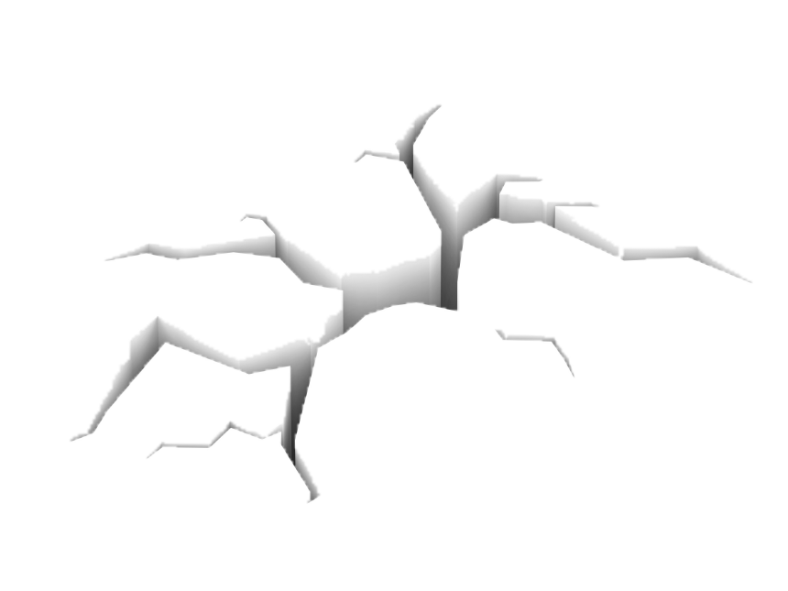
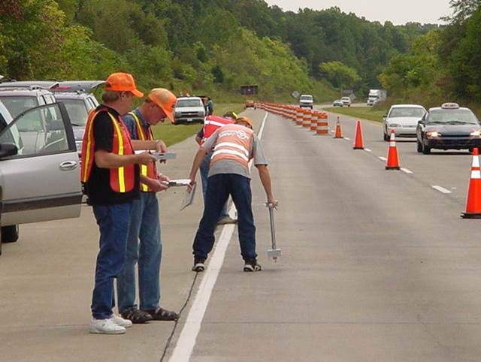
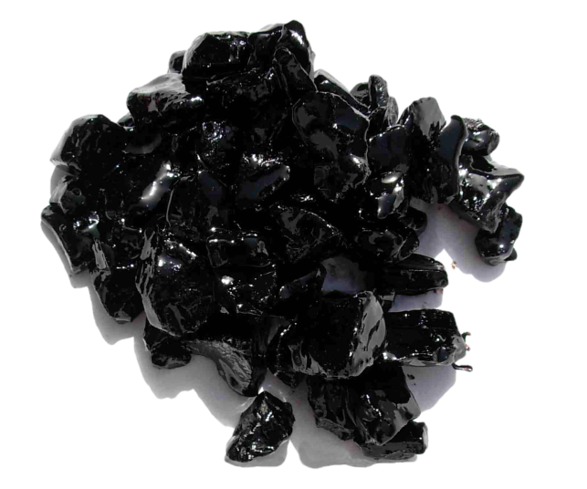

LOAD
CLIMATE
STRUCTURE
Data Collected
DISTRESS
MATERIALS
RESPONSE
Notes:
COLLECTED DATA
The collected pavement data include:

Climate

Traffic volumes and loads

Material properties

Pavement layer types and thicknesses

and pavement conditions, such as
structural response to loading (i.e., falling weight deflection)

distress, longitudinal & transverse profile, and surface texture

PAUSE
 - NEXT SLIDE

Slide 19

The Database
Largest Pavement Database
Over 300 Terabytes of Data
Web Interface Public Access
Notes:
DATABASE
The data is housed in the LTPP Database


Which is the world's largest pavement performance database,

With over 300 Terabytes of data

and is made available to the public via the LTPP Database web interface – LTPP InfoPave™, which we will discuss more of a little later on
PAUSE
 - NEXT SLIDE

Slide 20

Data Analysis
Provide Quality Control
Quantify Pavement Performance
Validate & Calibrate Procedures
Develop New Procedures
Notes:
DATA ANALYSIS
Analyzing the data to describe how pavements perform and to explain why they perform as they do.
Data Analysis involves:


Providing quality control of the data to ensure the data is of the highest quality

Quantify how pavements perform to understand why they perform as they do

Validate and calibrate existing procedures

And Develop new procedures
PAUSE
 - NEXT SLIDE

Slide 21

Product Development
Design
Maintenance
Construction
Preservation
Rehabilitation
Management
Notes:
PRODUCT DEVELOPMENT
Product Development involves Developing and Delivering Usable Tools – Translating data analysis insights into knowledge and usable engineering products related to:


Pavement Design

Construction

Rehabilitation

Maintenance

Preservation

And Management
PAUSE
 - NEXT SLIDE

Slide 22

Communication
Outreach & Visibility
Customer Support
Collaboration
Publications
Notes:
COMMUNICATION
Communication and outreach is extremely essential to the success of the LTPP program – LTPP recognizes the need to ensure that its partners and the pavement community in general have access to the best and latest knowledge resulting from the LTPP program, and are aware of current and future activities within the program
Communication with the pavement community involves:


Community Outreach & Visibility – to expand awareness of the LTPP program and maintain visibility in the Community by attending & participating in pavement community conferences, meetings, webinars, and State Highway Agency & Universities visits

Customer Support – to provide answers to specific questions, assist in data extractions, and provide training & workshops

Collaboration – to encourage partnerships between the pavement community and the LTPP program

And Publications – such as Brochures, Tech Briefs, Product Briefs, and Research Reports
PAUSE
 - NEXT SLIDE

Slide 23


In The Community
Notes:
IN THE COMMUNITY
In-line with LTPP’s community outreach strategy, during our visit to Missouri, we are here visiting:

The Missouri University of Science and Technology and Trine University, where we hope to gain valuable insight from the academic community
Future benefits will be achieved through the exposure of young engineers and researchers to the LTPP program and database
This has already begun, as many universities are incorporating the LTPP database in their undergraduate curriculum
Familiarity with the program will facilitate the implementation of LTPP products – and increased exposure to LTPP products will result in applications beyond those currently envisioned
PAUSE
 - NEXT SLIDE

Slide 24
Benefits
Notes:
BENEFITS
Over the past 28 years of data collection, LTPP has produced a wide array of accomplishments and benefits and has created a variety of innovative products for highway agencies and researchers to utilize
Through partnership with key program stakeholders, the LTPP program has worked to fulfill each of its original objectives, with the ultimate goal of extending pavement life through better understanding of the factors that affect performance
PAUSE
 - NEXT SLIDE

Slide 25

Database
Research-Quality Data
Almost 3 Decades of Data
Research & Development
Geographic Diversity of Data
Only National In-Service Data
Notes:
DATABASE
The program’s single most significant achievement to date, is the LTPP database itself
It is an unprecedented resource that will provide the pavement performance data needed to answer all kinds of questions—even those we have not yet conceived
The database contains more
research-quality pavement data than anywhere else
Contains almost 3 decades of consistently collected data
And has been the support for many research and product development projects
Allows objective comparisons of data between geographic locations
Only national source of in-service pavement data
PAUSE
 - NEXT SLIDE

Slide 26

Measurement Processes
Data Collection Procedures
Standard WIM & AVC Formats
FWD Calibration Procedures
Lab Testing Procedures
Notes:
MEASUREMENT PROCESSES
The LTPP Program has contributed to advances in pavement engineering practice in many ways
The test methods, guidance, and data processing procedures developed to support and ensure consistency in LTPP data collection and testing formed the basis for more widely used Measurement Processes, such as:

Various Data Collection Procedures, like Distress Identification

Standardized Traffic data formats for WIM and AVC

Calibration procedures for falling weight deflectometers (FWD’s)

And various Lab Testing procedures, like bound and unbound resilient modulus
PAUSE
 - NEXT SLIDE

Slide 27
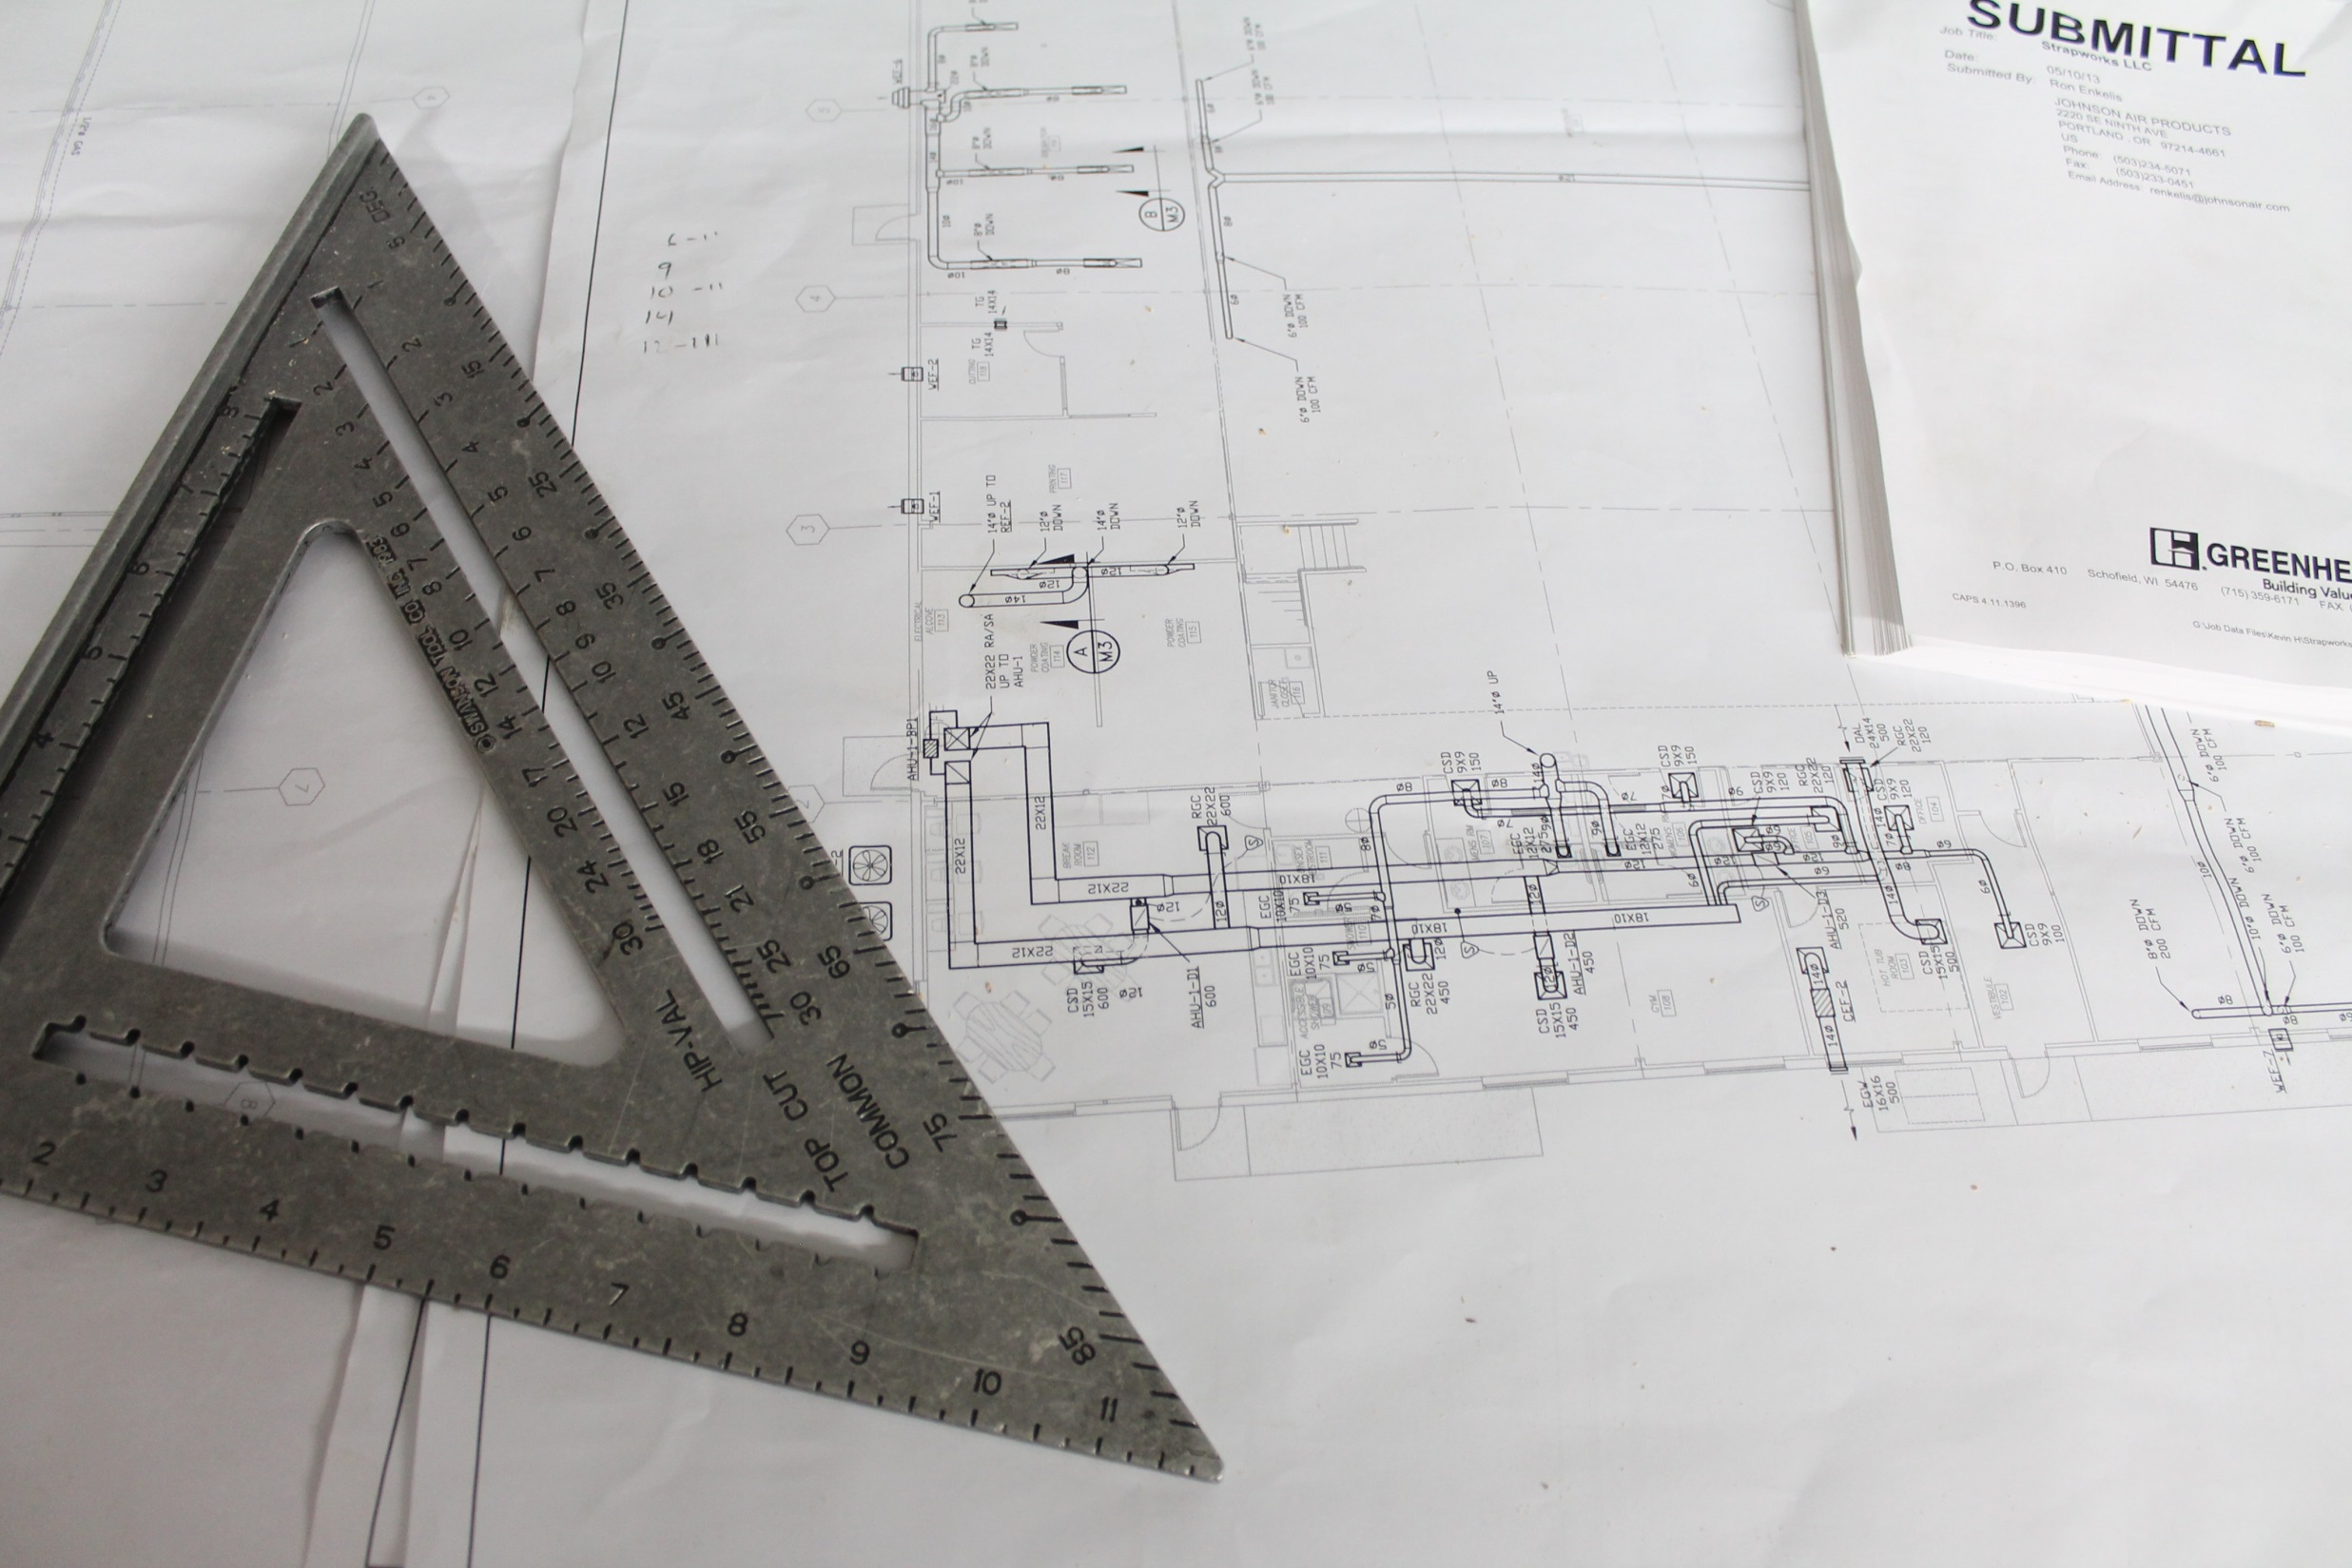
Pavement Design & Management
More Realistic Design Models
Improved Understanding
Guidance to Support Design
Pavement Design Methodologies
Notes:
PAVEMENT DESIGN & MANAGEMENT
LTPP data documents the performance of an extensive array of pavement designs, in a wide range of service conditions, making possible the calibration and validation of broadly applicable models to predict pavement performance
LTPP data has contributed to more cost-effective highway pavements by providing:
More realistic pavement design models
Improved understanding of how and why pavements perform as they do
Guidance to support selection of the most cost-effective pavement design features for a given set of design constraints
Critical role in every major pavement design methodology developed in the past 28 years
The LTPP database has played a critical role in the development and evaluation of every major pavement design methodology developed over the past 20 years. This includes the 1993 and 1998 AASHTO design procedures, SuperPave®, and—most recently—AASHTO’s Mechanistic-Empirical Pavement Design Guide (MEPDG)
The MEPDG would not have been possible without LTPP data for many inputs. Calibrated nationally with LTPP sections, the MEPDG has shown significant reductions in the initial cost for heavily trafficked pavement designs, and its use is expected to generate annual savings of $1 billion
PAUSE
 - NEXT SLIDE

Slide 28

Rigid Pavement Design
FWD Calibration Centers
Distress Identification Manual
LTPPBind Software
Pavement Performance Forecast
WIM Cost Analysis
Products
Dynamic Modulus Prediction
Pavement Loading User Guide
InfoPave
Notes:
PRODUCTS
The LTPP program has generated a wide range of products all across the pavement engineering and performance spectrum

The following is a sampling of products developed from the LTPP program:

The Rigid Pavement Design Software,

Regional FWD Calibration Centers,

The LTPP Distress Identification Manual (aka DIM),

LTPPBind Software,

Pavement Performance Forecast,

WIM Cost Analysis software,

LTPP Dynamic Modulus Prediction software

The Pavement Loading User Guide (aka LTPP-PLUG),

ProVAL,

DiVA,

And of course, InfoPave
PAUSE
 - NEXT SLIDE

Slide 29

Strategic Analysis Plan
Guides Analysis Efforts
Categorized by Objectives
FHWA, NCHRP, or Pooled Funds
Interactive Interface – InfoPave
Notes:
STRATEGIC ANALYSIS PLAN
Since 1990, LTPP data has been implemented in hundreds of research analyses to study long-term pavement performance trends with the goal of enhancing pavement design and management practices
These research efforts have been

guided by the Strategic Plan for LTPP Data Analysis

This plan categorizes the corresponding analysis efforts according to the identified research objectives and provides a list of completed, ongoing, planned, and proposed research projects

Funded through FHWA, NCHRP, or pooled fund projects, these analyses have resulted in significant advancements in pavement engineering and management

The latest version of the Strategic Plan for LTPP Data Analysis is available as an interactive interface feature on InfoPave that facilitates filtering and sorting through various research efforts
PAUSE
 - NEXT SLIDE

Slide 30
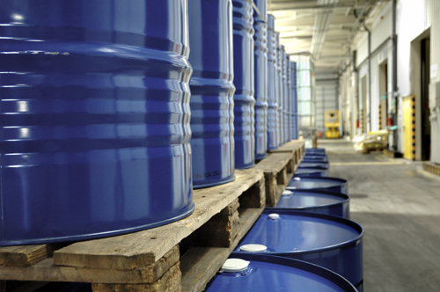
Materials Reference Library
Samples of the Materials
>1,000 Tons of Materials
Cores, Cement, Aggregate…
Future Research Projects
Notes:
MATERIALS REFERENCE LIBRARY
The LTPP Materials Reference Library offers researchers

samples of the materials used to construct LTPP test sections over the past 28 years

The library consists of more than 1,000 tons of materials,

including pavement cores, asphalt cement, portland cement, and aggregate

The library ensures that materials used in LTPP sections will be available for

future research projects
PAUSE
 - NEXT SLIDE

Slide 31

Benefits Grow
“
Learning, Testing, and Applying Findings & Products of LTPP…
Notes:
BENEFITS GROW
The number of ways in which the transportation community can benefit from the LTPP program continues to grow, but the extent to which it can benefit will depend on the

investment made in learning about, testing, and applying the findings and products of LTPP
PAUSE
 - NEXT SLIDE

Slide 32
LTPP InfoPave™
Notes:
LTPP INFOPAVE
Now we’ll take a look at LTPP InfoPave…
How many of you have used LTPP data in the past, prior to InfoPave? – “Standard Data Releases (SDRs)”
Okay, for those who have, you can appreciate that InfoPave is a huge leap forward in user friendliness
PAUSE
 - NEXT SLIDE

Slide 33


Web Interface
Primary Source
On Demand
…You Ask
Integrated Tools
Notes:
WHAT IS IT?...YOU ASK
What is InfoPave you ask?
Let’s take a step backwards…
Prior to InfoPave, LTPP data was disseminated to the public via annual Standard Data Releases (as some of you may recall), on DVD’s and more recently on USB thumb drives
But in January 2014

LTPP InfoPave™

A Web interface program for the LTPP database, was launched to serve as the

primary source of LTPP data and information
LTPP InfoPave provides

on demand access to the LTPP Database and Ancillary Data
It also provides

tools to maximize user understanding and utilization of the information…It is a one stop shop for LTPP data
PAUSE
 - NEXT SLIDE

Slide 34
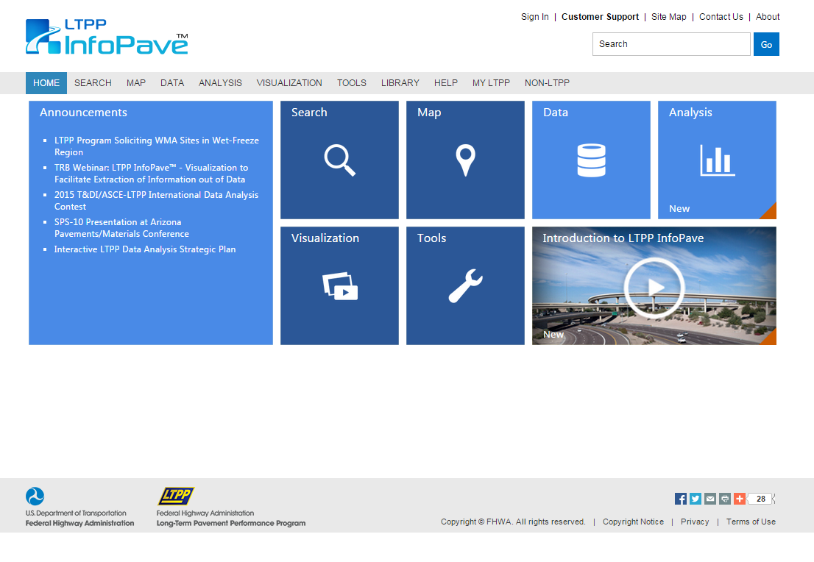
ALL User Level
View
Visualize
Students
Extract
Researchers
Employ
Professionals
Notes:
MUS&TBLIC ACCESS
The Web-centric interface provides a powerful and flexible tool that enables

users of all levels

Students

Researchers

And Professionals

to view

Visualize

Extract

and employ LTPP data
PAUSE
 - NEXT SLIDE

Slide 35
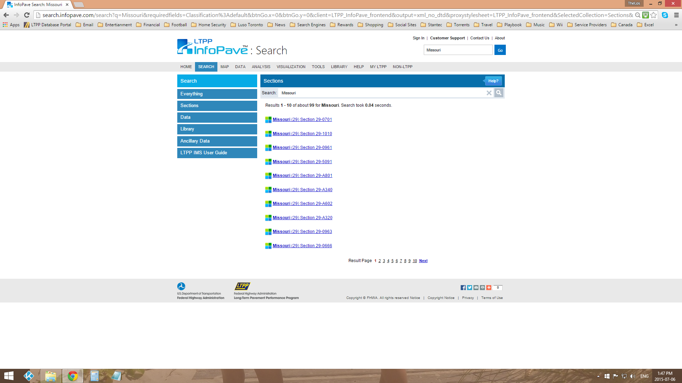
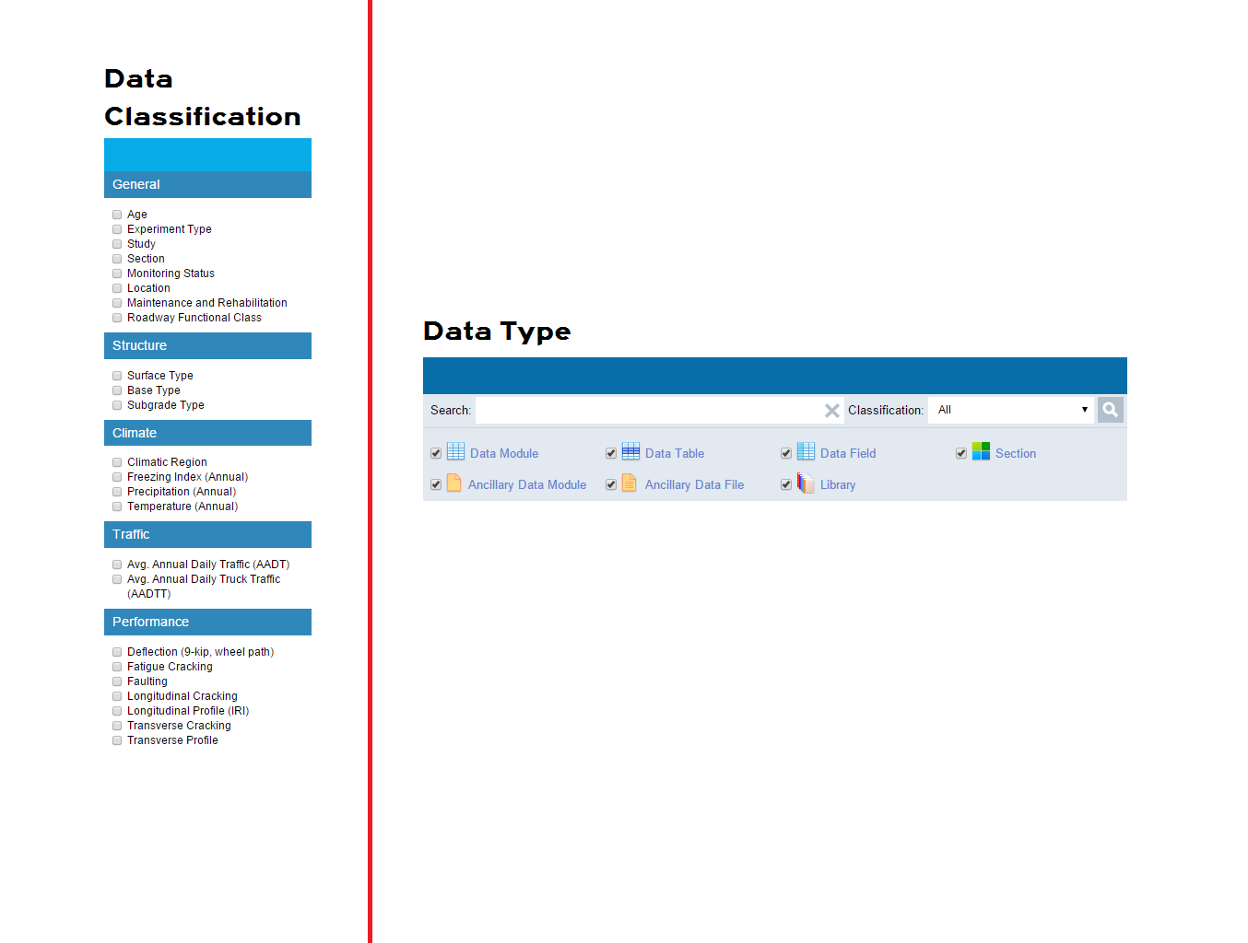

Search
Contextual Search ➔ Google
Test Section Search ➔ Missouri
Data Search ➔ Traffic
Filters ➔ Data Classification
➔ Data Type
Notes:
SEARCH
One of the most powerful feature on InfoPave is the numerous ways to SEARCH for what you are looking for

Contextual Search – Similar to the Google experience, the Search feature allows you to locate data or documents. A list of appropriate topics, with the highest rated response displayed at the top of the list, will be presented for your selection

LTPP Test Section Search will help you find sections of interest, for example, searching for the word “Missouri" will return all LTPP test sections within the state of Missouri

Data Search allows you to search for information only within the Data collection, for example, searching the term "traffic" will return all related data tables and data fields related to traffic information

Search Filters allow you to narrow down the information you want returned, you can filter by

Data Classification, such as Climate, Structure, Performance, or Traffic, and/or you can filter by

Data Type, such as Data Table, Library Data, or Ancillary Data
PAUSE
 - NEXT SLIDE

Slide 36
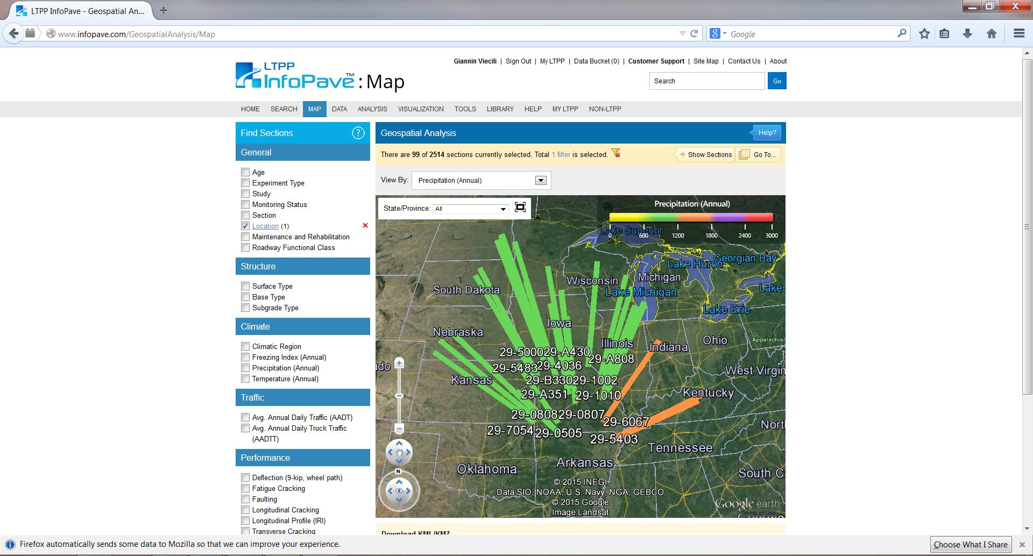
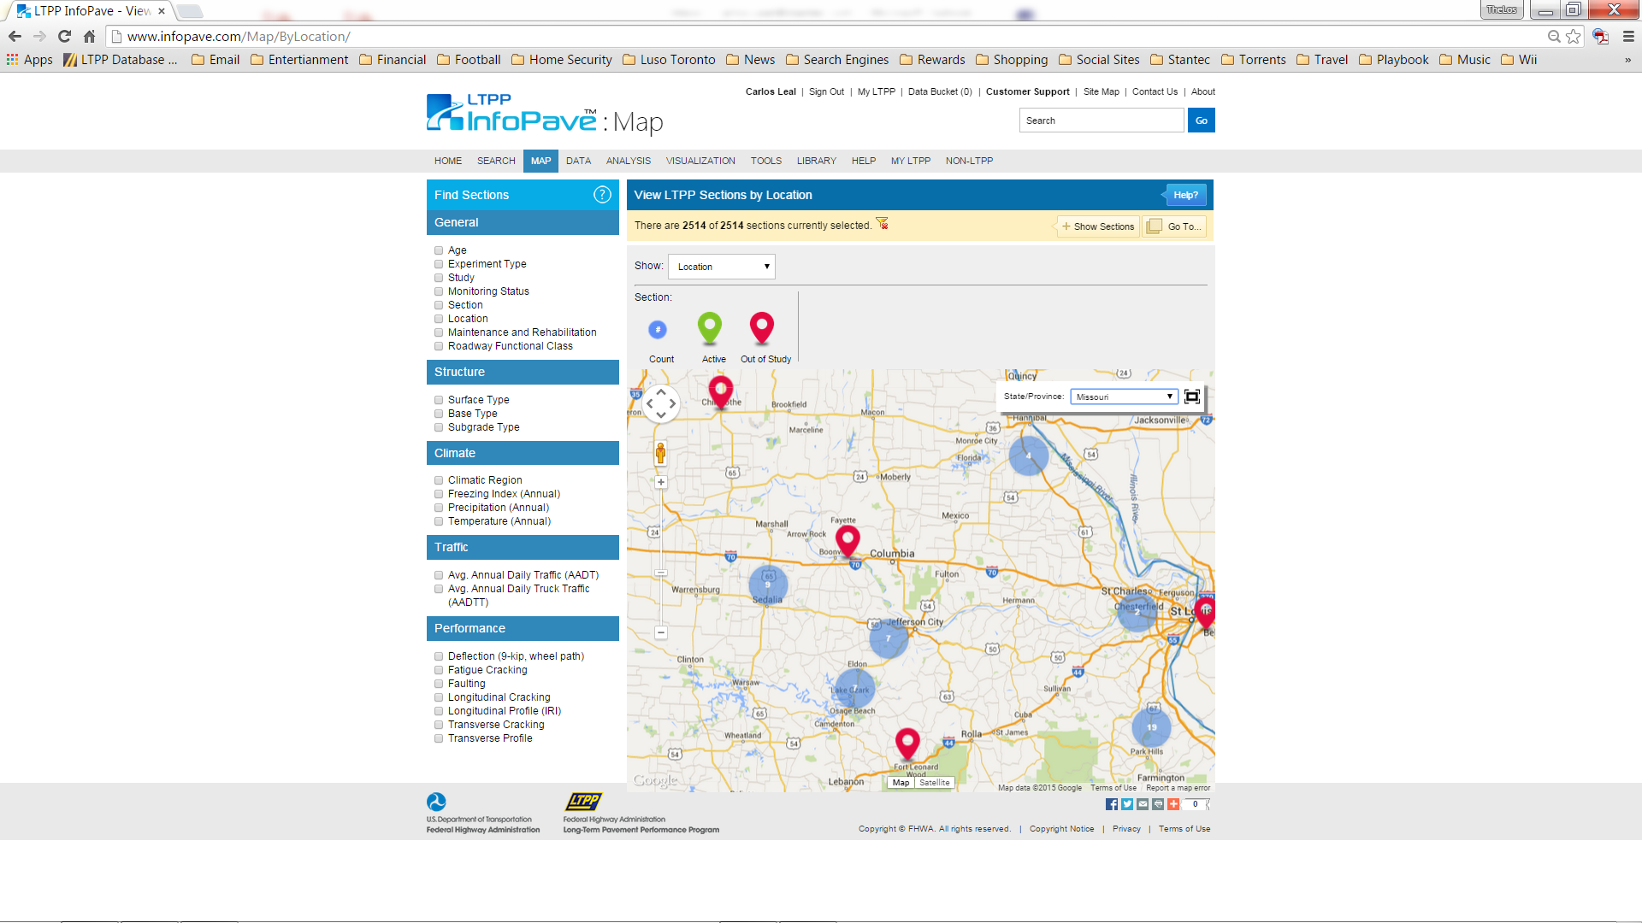
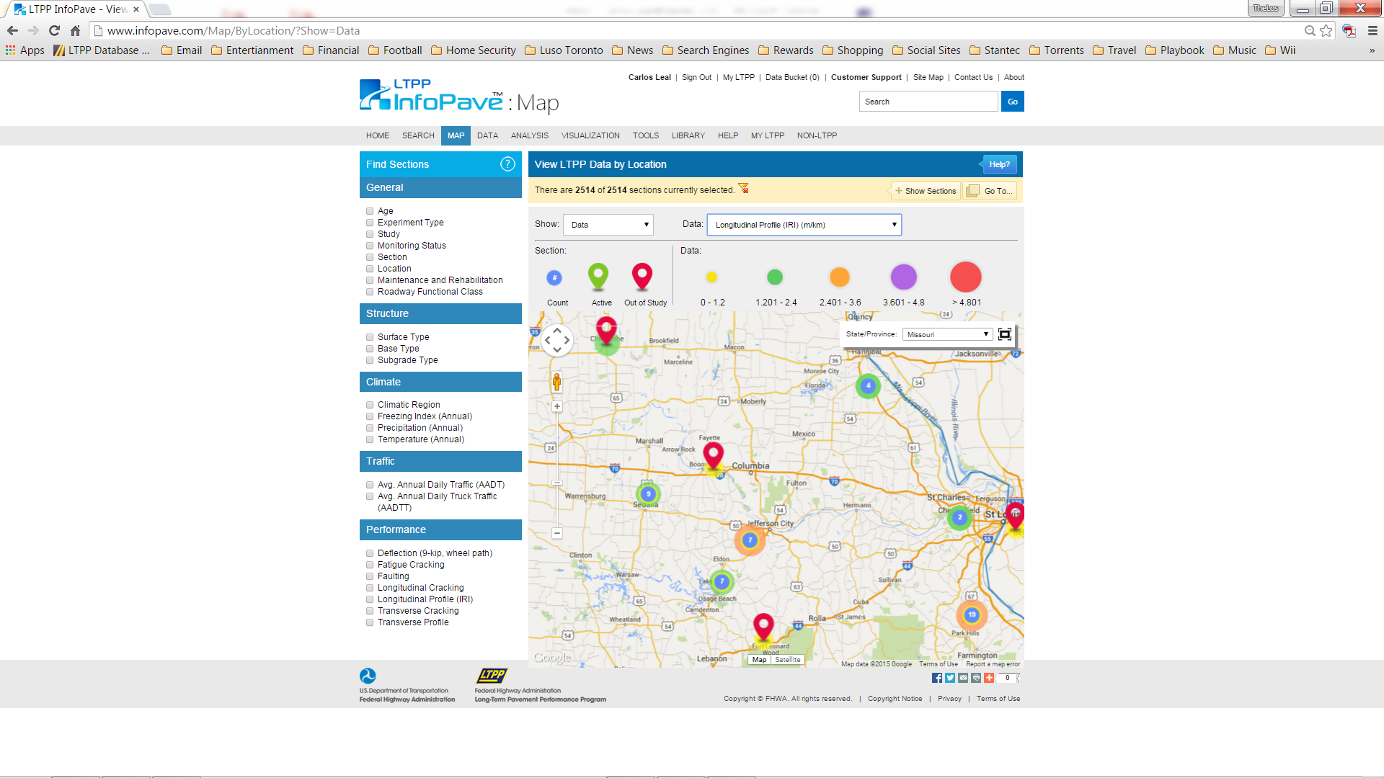

Map
Map LTPP Geographically
Test Sections by Location
Data by Location
Zoom, Pan, & Filter
Geospatial Analysis
Notes:
MAP
The Map feature allows users to

Map LTPP Geographically on Google Maps – it displays locations geographically and shows major landmarks, such as cities, highways, and State lines
You can choose to either:

View LTPP Test Sections by Location – which allows you to display LTPP pavement test sections geographically

Or you can View LTPP Data by Location – which allows you to display selected data attributes, such as surface type, climatic region, or performance measurement, associated with the LTPP sections geographically

The map feature provides the ability to

zoom in and out, pan and filter section results using any combination of defined categories

The Geospatial Analysis feature is designed to select data elements to be displayed on Google Earth maps, allowing users to statistically analyze data geographically
PAUSE
 - NEXT SLIDE

Slide 37
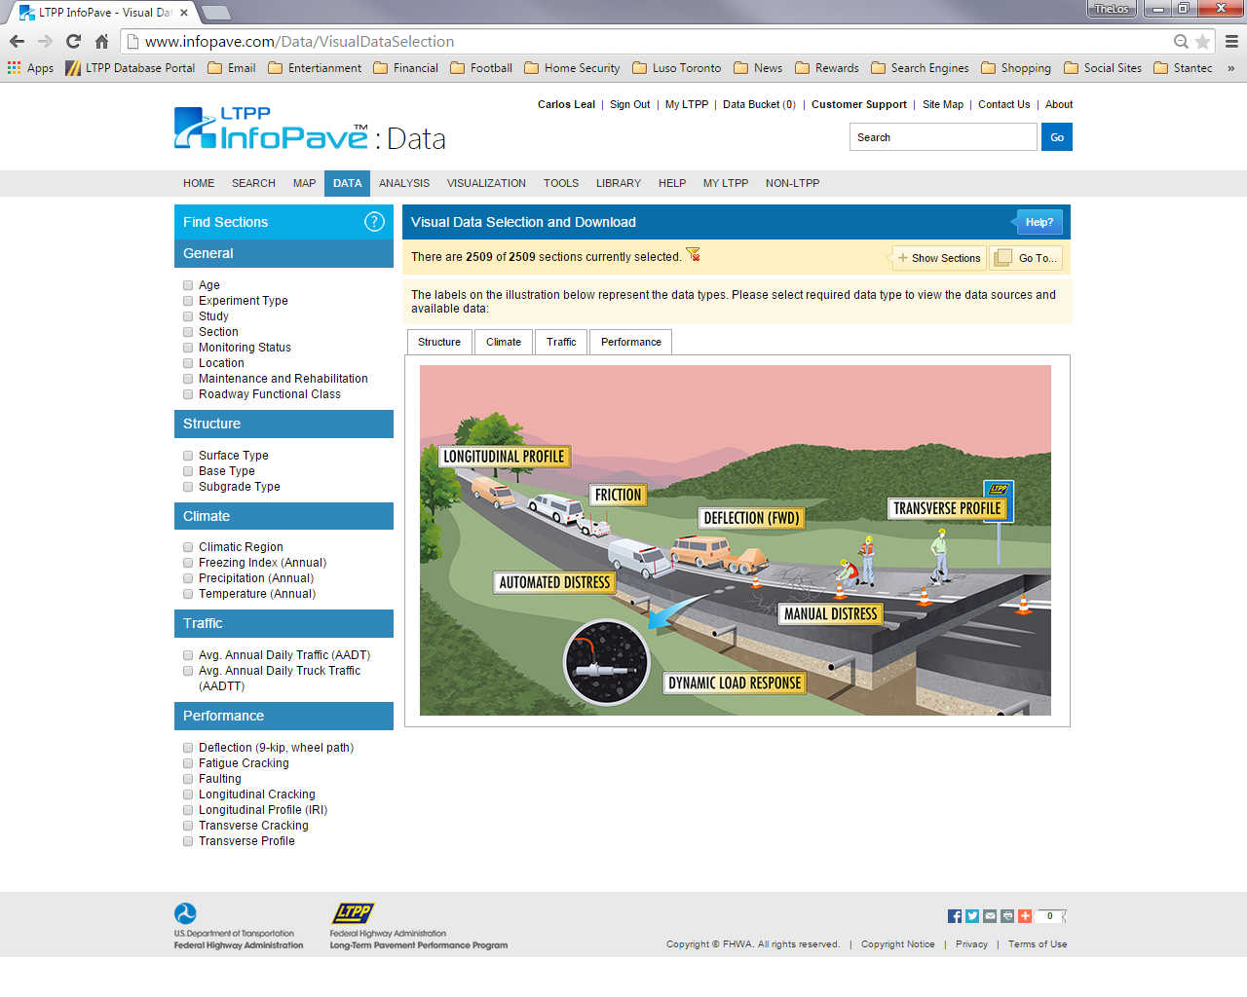
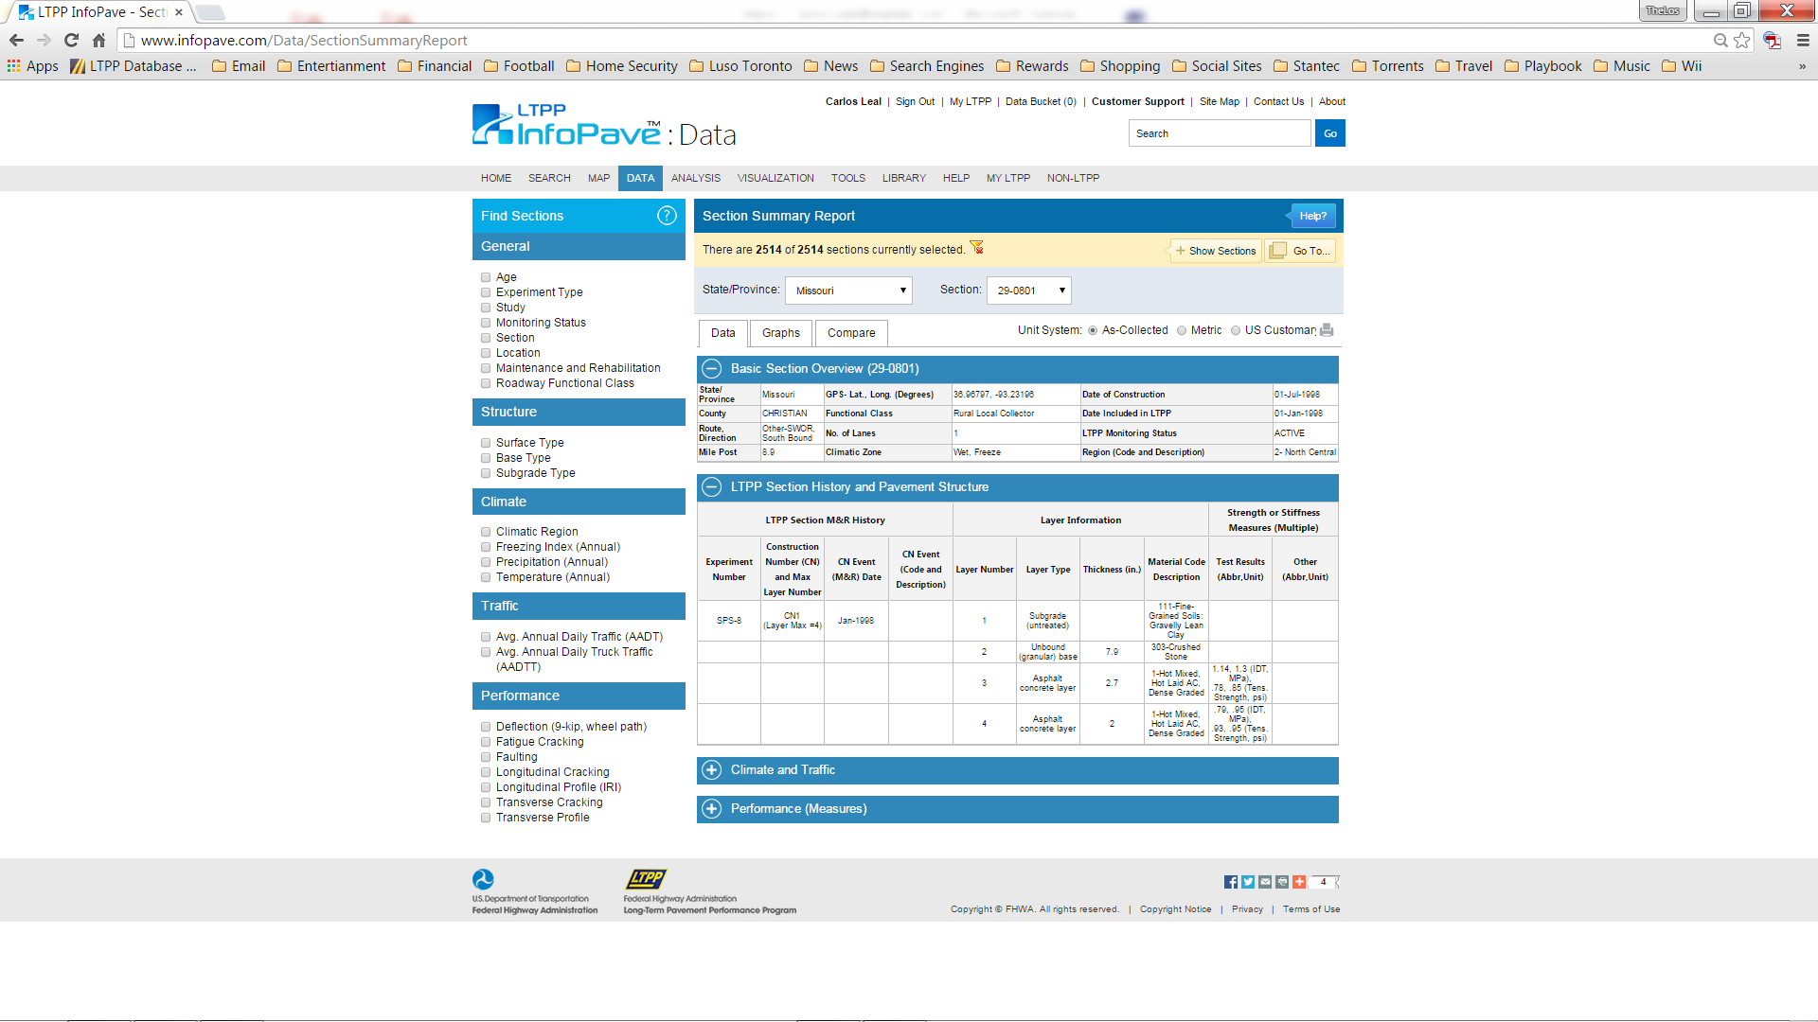

Data
Data Selection & Download
Visual Data Selection
Section Summary Reports
Ancillary Data
Table Export & SQL Export
Notes:
DATA
InforPave has numerous ways for a user to find and extract the data they are looking for, these are a few of them:

Data Selection & Download is an extremely powerful filtering tool, which allows users to use a verity of filtering options designed to help users sort and prioritize their data needs

The Visual Data Selection tool, provides illustrated representations of LTPP data, the illustrations facilitate in the selection of data elements, making it quick and easy for the novice user

Section Summary Reports provide an overview of key data corresponding to single or multiple LTPP test sections, in addition, this feature allows for a graphical display and comparison of the long-term performance trends, such as IRI, Rutting, and Deflection

LTPP Ancillary Data has also been made available, on demand, to the public via InfoPave, this includes such data as FWD Time History Data, Distress Maps, and Point-by-point road profiles

For the more advanced users (like myself, haha), who are familiar with LTPP Database tables and know exactly what they are looking for, Infopave has provided advance features like Table Export, if you know exactly the table you need, and SQL Export for those familiar with SQL
PAUSE
 - NEXT SLIDE

Slide 38
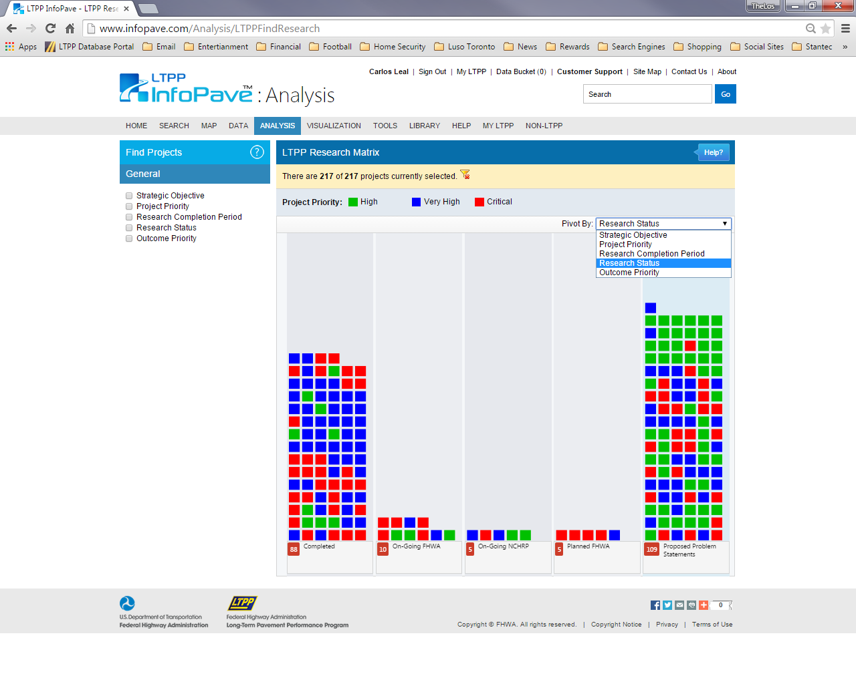
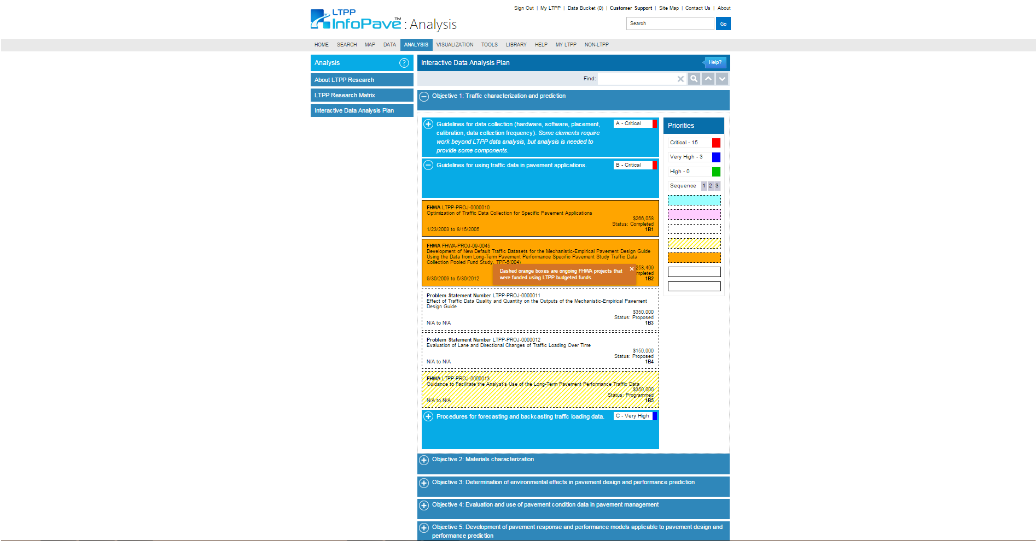

Analysis
Interactive Data Analysis Plan
LTPP Research Matrix
Notes:
ANALYSIS
The InfoPave Analysis Hub was designed to facilitate access to LTPP research projects and analysis of LTPP data

The Interactive Data Analysis Plan allows easy access to LTPP data analysis projects, the feature allows users to view and prioritize research projects on the basis of different attributes and selection criteria

The LTPP Research Matrix feature is based on the LTPP Strategic Data Analysis Plan, it organizes all the ongoing and completed research projects and ideas for future research according to various topics. The feature lets users find research that is completed, in progress, or planned using LTPP data

PAUSE
 - NEXT SLIDE

Slide 39
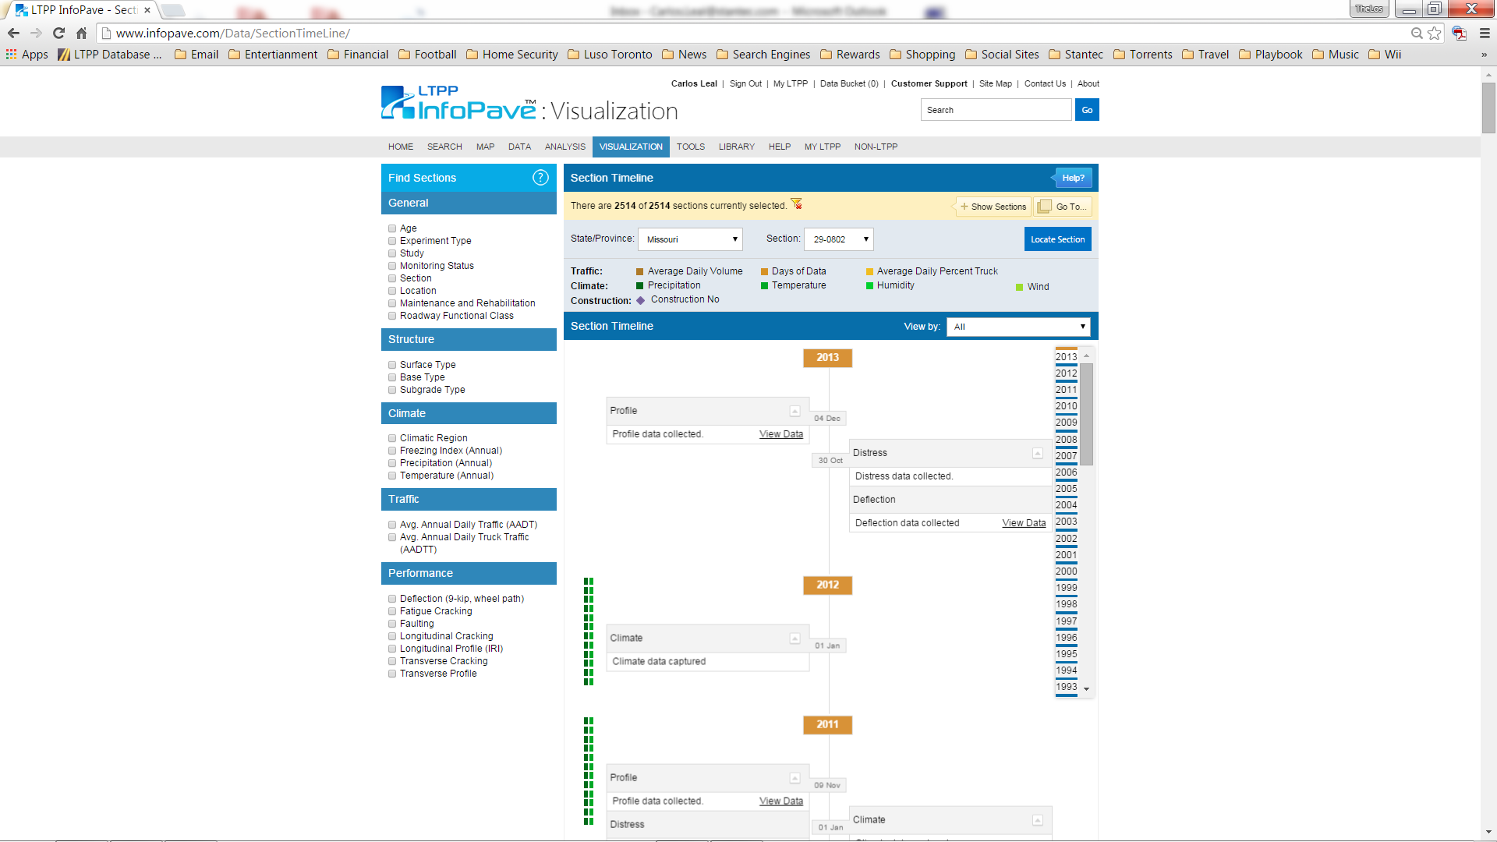
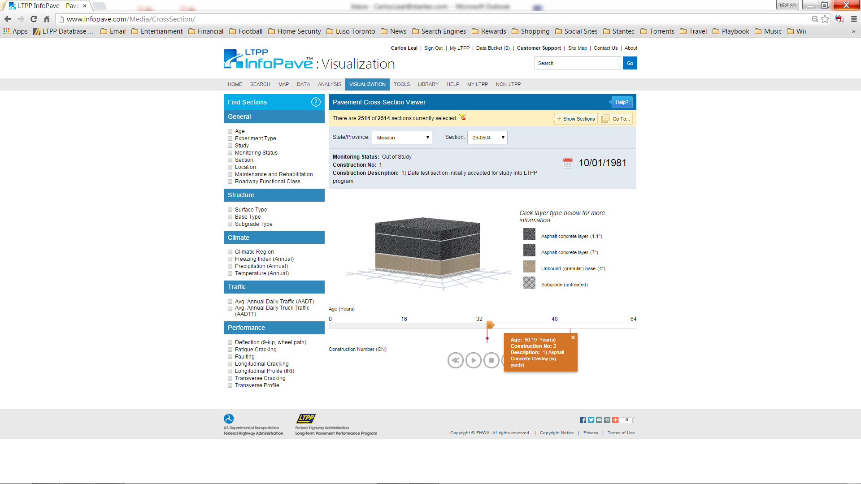
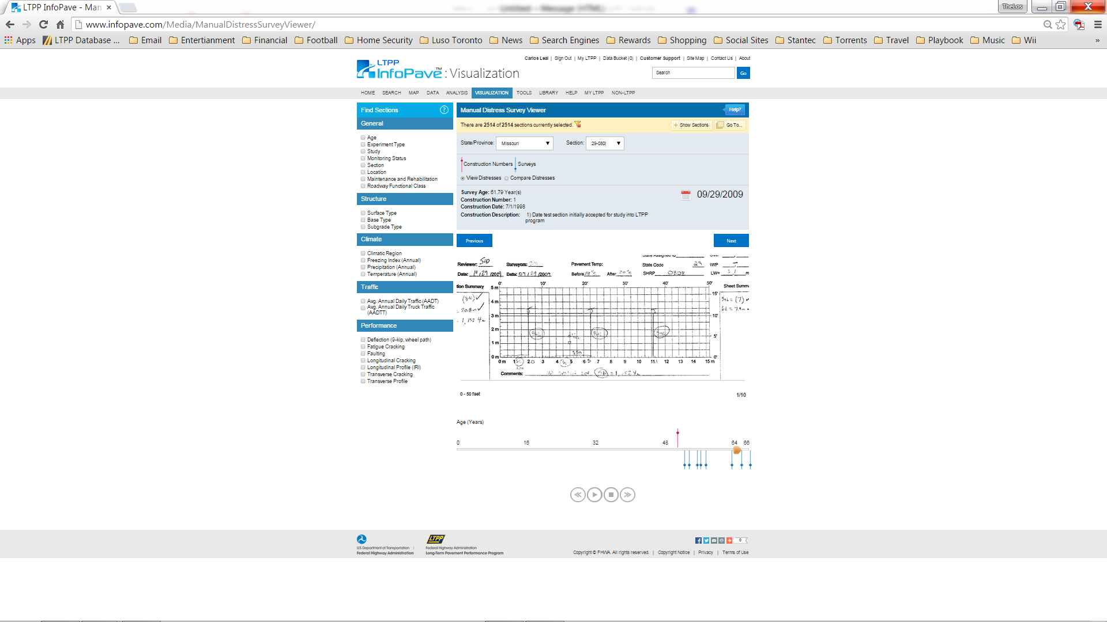
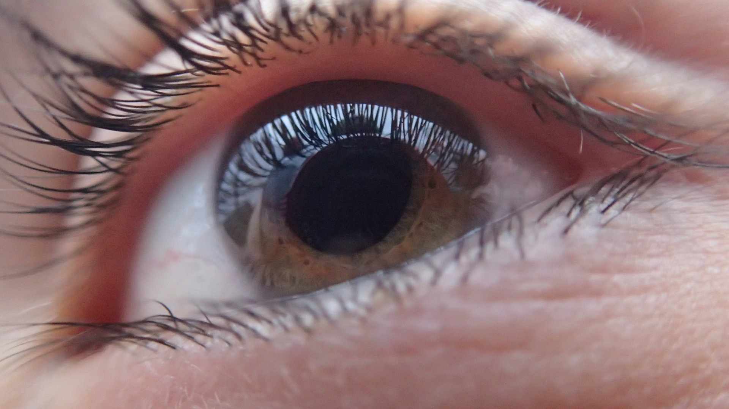
Visualization
Section Timelines
Pavement Cross-Section Viewer
Manual Distress Survey Viewer
Inspection Videos
Distress Maps & Images
Notes:
VISUALIZATION
There are a variety of user-friendly dynamic interfaces on InfoPave which visualize LTPP data; including:

The Section Timeline – which provides the event history of each LTPP section, including the construction, maintenance or rehabilitation, and performance monitoring activities that occurred during the life of the test section

The Pavement Cross-Section Viewer, which provides a visual display of the pavement structure, including the material type and thickness of various layers for each LTPP test section over time

The Manual Distress Survey Viewer displays the distress maps prepared during the LTPP manual distress surveys for each LTPP test section, allowing for time history comparisons
The Visualization Hub also provides access to:

Test Section Inspection Videos – allowing users to watch videos of the LTPP pavement sections which were collected during the Manual Distress or Profile Surveys

And the Distress Maps & Images, which allows users to view or download the collected Distress Maps or Photographs for each LTPP test Section
PAUSE
 - NEXT SLIDE

Slide 40
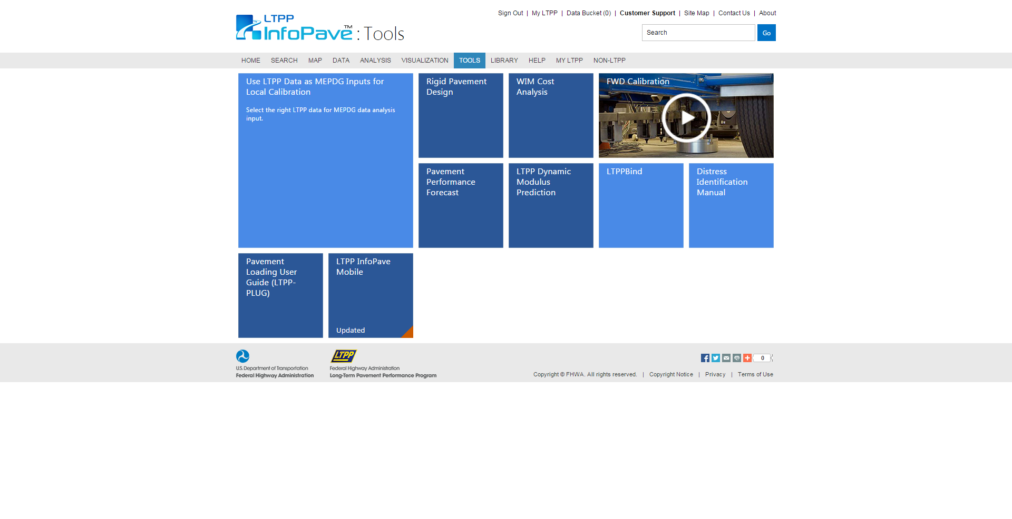

Tools
LTPP Software
MEPDG Inputs
FWD Calibration Video
Distress Identification Manual
InfoPave™ Mobile
Notes:
TOOLS
The Tools Hub on InfoPave provides users access to:

LTPP Software, such as the Pavement Loading User Guide (aka LTPP-PLUG), WIM Cost Analysis, the Pavement Performance Forecast, and LTPPBind
The Tools Hub also provides access to:

MEPDG Inputs for Local Calibration

An FWD Calibration Video explaining the process and importance of calibrating an FWD

The LTPP Distress Identification Manual (aka LTPP-DIM)

And InfoPave Mobile, for fast and easy on-the-go access to LTPP InfoPave
PAUSE
 - NEXT SLIDE

Slide 41
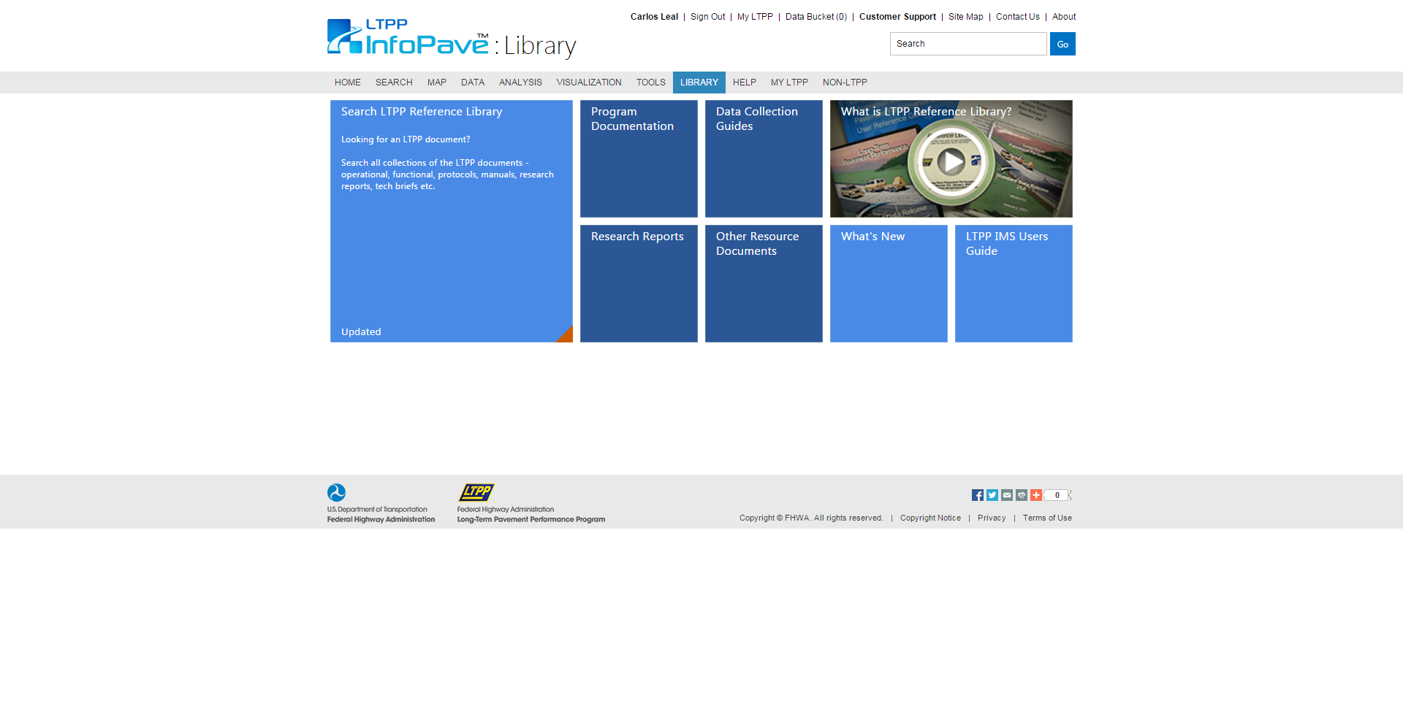

Library
Program Documentation
Research Reports
Data Collection Guides
Other Resource Documents
What’s New
Notes:
LIBRARY
The InfoPave Library provides users access to an extensive set of LTPP documents, such as:

Program Documentation, which contains publications such as Experiment Designs, and Construction Reports

Research Reports, which contains reports on the findings of analysis of LTPP data

Data Collection Guides, which contains LTPP data collection documents used both in the laboratory and the field

And Other Resource Documents, which contains other miscellaneous LTPP documents and publications, such as Product and Tech Briefs, Brochures, and Forensic Documents

The Library Hub also provides access to the

“What’s New” section, where users can read about the latest happenings at the LTPP program
PAUSE
 - NEXT SLIDE

Slide 42

Non-LTPP
Canadian LTPP (C-LTPP)
Accelerated Pavement Testing
WesTrack
Other – State or University
Notes:
NON-LTPP
One of InfoPave’s goals is to become the “Go-To” site for everything pavements – the hosting of Non-LTPP Data is a good start!
The Non-LTPP Hub was designed to provide access to data sources other than LTPP that can be used in pavement engineering and research

The Canadian LTPP (C-LTPP) database is the first data source to be added
But several other data sources are being considered for similar future incorporation in InfoPave. These additional sources include but are not limited to:

Accelerated Pavement Testing (APT) data sources, such as WesTrack

And other State or University research data sources
PAUSE
 - NEXT SLIDE

Slide 43
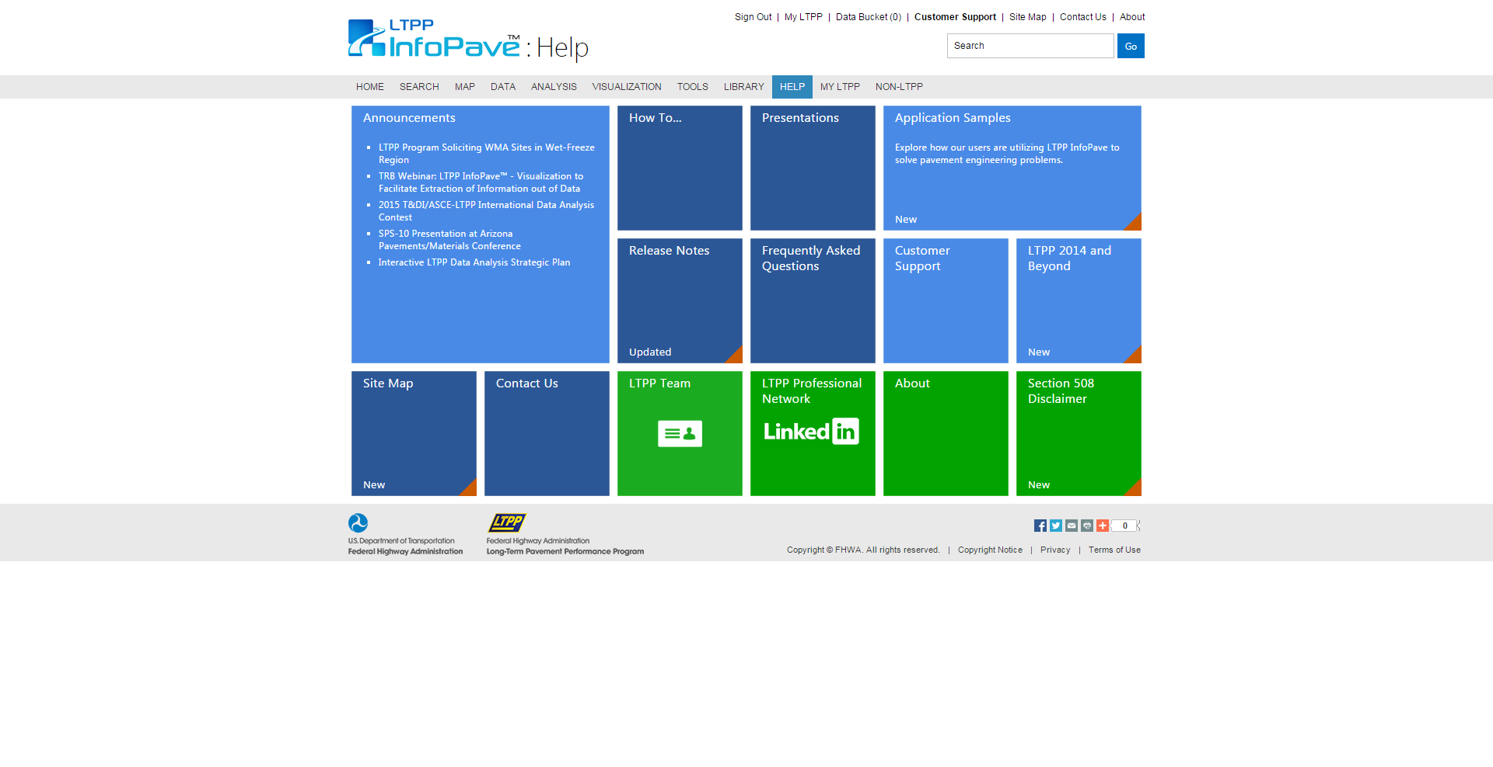

Help
How To…
Presentations
Frequently Asked Questions
Application Samples
Customer Support
Notes:
HELP
The InfoPave Help hub, provides users with multiple sources to get the help they require, such as:

The “How To…” video collection, which are step-by-step instructional videos on “How To” use the various aspects of InfoPave

The Presentations section contains a library of LTPP program presentations completed over the years

There is also a “FAQ” section, Frequently Asked Questions, with a collection of questions most frequently asked by users – along with answers to those questions

The Application Samples, allow you to explore how other users are utilizing LTPP InfoPave to solve pavement engineering problems

And if you still cant find the answer your looking for…or if you just prefer to go there right away, there is a Customer Support section, which will put you in direct contact with an LTPP InfoPave representative
PAUSE
 - NEXT SLIDE

Slide 44


“For Everyone…”
“Browsing for Inspiration…”
“Vastly More Interactive…”
What do YOU Think?
…Let Us Know!
User Feedback
Notes:
USER FEEDBACK
We have received a lot of user feedback on InfoPave over the past year, here are a few examples of what users are saying:

InfoPave is vastly more interactive than previous modes of access to LTPP data

InfoPave encourages browsing of LTPP data for inspiration

InfoPave is great for those who are not LTPP data experts, InfoPave has been tailored for EVERYONE!


What do you think of LTPP InfoPave?

…Let Us Know!

What you like and what we can improve, user feedback is important and is highly valued at the LTPP program
PAUSE
 - NEXT SLIDE

Slide 45
Latest Data Release
June 30th
Knowledge into Action… Performance Data for Pavement Innovation
www.InfoPave.com
Notes:
INFOPAVE - WEBSITE


With LTPP InfoPave, LTPP data are at users’ fingertips, allowing them to obtain the right data efficiently and effectively

The LTPP InfoPave represents a complete body of knowledge, not just data

With the 2014 data collection cycle completed, a dataset reflecting over two-and-a-half decades of data collection will soon be available

The Next LTPP Data release is scheduled to go live on InfoPave on

June 30, 2015

PAUSE
 - NEXT SLIDE

Slide 46
Missouri Sections
Notes:
Missouri SECTIONS UPDATE
In the next Section we will look at the LTPP test sections in Missouri and provide an update on them
PAUSE
 - NEXT SLIDE

Slide 47
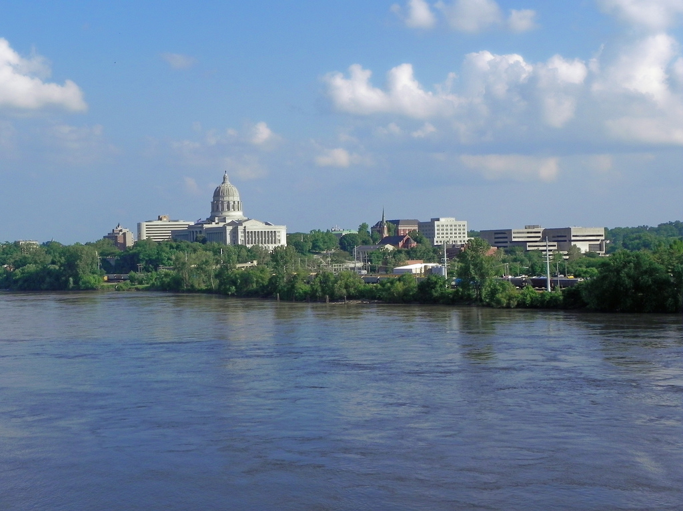
Active & Closed
Total Test Sections ➔ 99
Closed Test Sections ➔ 95
Active Test Sections ➔ 4
Notes:
ACTIVE & CLOSED
We’ll start off by reviewing the active and closed test sections

Missouri at it’s peek had 18 LTPP test sections

over the years, 17 of those sections have been placed out of study

and only 1 active test section remains in Missouri
PAUSE
 - NEXT SLIDE

Slide 48
Active Test Sections
MISSOURI
SECTION | EXPERIMENT | STATUS | HIGHWAY | DIRECTION | LATITUDE | LONGITUDE
290801 | SPS-8 | ACTIVE | Highway-SWOR | South Bound | 36.96797 | -93.232
290802 | SPS-8 | ACTIVE | Highway-SWOR | South Bound | 36.96619 | -93.232
290807 | SPS-8 | ACTIVE | Highway-SWOR | South Bound | 36.96265 | -93.2321
290808 | SPS-8 | ACTIVE | Highway-SWOR | South Bound | 36.96442 | -93.232
Notes:
TEST SECTIONS
Here is an overview of all 18 Missouri LTPP test Sections
Highlighting the 1 active Section, which is currently a GPS-6B experiment
PAUSE
 - NEXT SLIDE

Slide 49
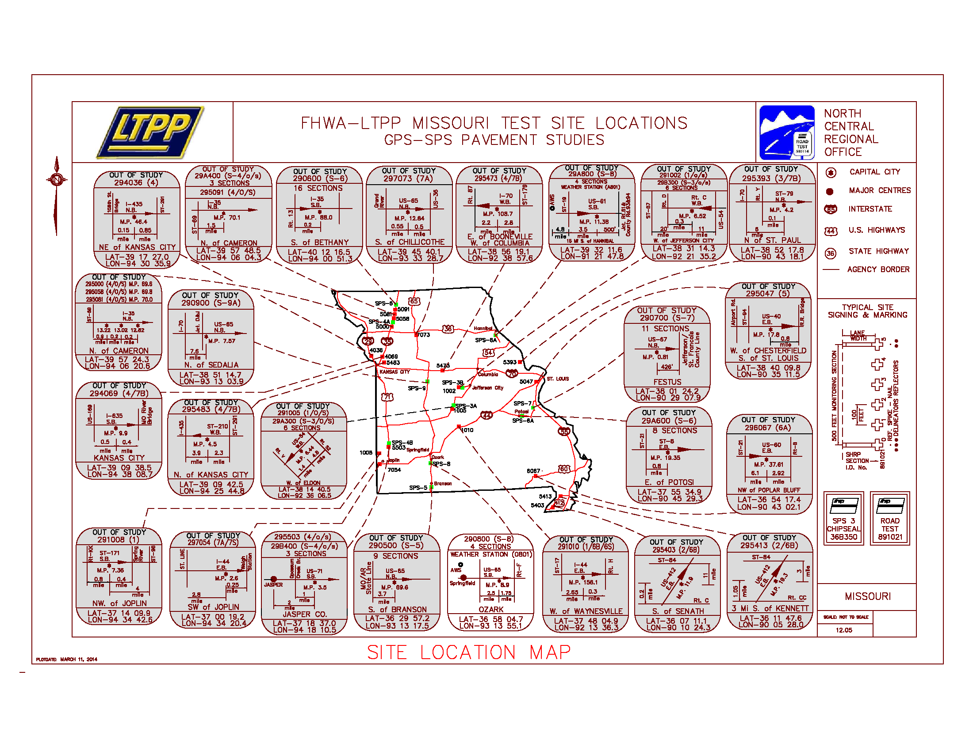
Notes:
SITE LOCATIONS
This is a map of the LTPP Missouri test sections
PAUSE
 - NEXT SLIDE

Slide 50
Active Monitoring Status
MISSOURI
SECTION | EXPERIMENT | PROFILE |  |  | DISTRESS |  | TRAFFIC |  | FWD | FRICTION
 |  | LONGITUDINAL | TRANSVERSE | TEXTURE | MANUAL | PHOTO | MONITORED | ESTIMATED
290801 | SPS-8 | 9 | 9 | 1 | 9 | 1 | 1 | 0 | 5 | 0
290802 | SPS-8 | 9 | 10 | 1 | 9 | 1 | 1 | 0 | 5 | 0
290807 | SPS-8 | 9 | 2 | 1 | 9 | 1 | 1 | 0 | 5 | 0
290808 | SPS-8 | 9 | 2 | 1 | 8 | 1 | 1 | 0 | 5 | 0
Notes:
MONITORING STATUS
This is an update of the LTPP monitoring status of Missouri test sections
Once again highlighting the 1 active section
As you can see by the totals at the bottom, there has been quit a lot of data collected in Missouri over the years
PAUSE
 - NEXT SLIDE

Slide 51

North Central
Regional Office
Monitoring Status
Monitoring Schedule
NCRO People
www.LTPP.Stantec.com/NCRO
Notes:
NCRO
As mentioned, Missouri is in the North Central Region of the LTPP program, and for information on regional operations, such as:

Test Section Monitoring Status

Our Monitoring Schedule

Or to find NCRO Contacts

Please visit our website – www.LTPP.Stantec.com/NCRO
PAUSE
 - NEXT SLIDE

Slide 52
2015 & Beyond
Notes:
2015 & BEYOND
The exact relationship between the investments made in LTPP and the benefits accrued is difficult to calculate
However, what we do know is that if we do not seize the opportunity to invest in learning about, adopting, adapting, and applying the findings and products of LTPP, we will not achieve all the benefits that are possible
In this next section we will review current and future activities at the LTPP program
PAUSE
 - NEXT SLIDE

Slide 53

“
Research is a
Never-Ending
Process…
More
Research
Notes:
WORK NOT COMPLETE
Just as the sign says “road work ahead”
The LTPP Program has contributed to advances in pavement engineering in many ways, but with advancements in Technology, our understanding and knowledge of pavements and how they preform and the fact that there are still SO many unanswered questions…

It’s true that Research is a never ending process!
PAUSE
 - NEXT SLIDE

Slide 54

Backcalculation
Macrotexture
MERRA
Data Analysis Projects
new Experiment
Notes:
OPPORTUNITY
And because research is never ending, many opportunities for the pavement community exist ahead
The LTPP program is currently working on the following to assist in further advancements of our knowledge of pavements:

Providing Backcalculation of LTPP Data

Providing Surface Macrotexture Measurements

Making MEERA Climate Data available on InfoPave

And undergoing a new pavement experiment
PAUSE
 - NEXT SLIDE

Slide 55

Backcalculation of LTPP Data
ALL LTPP Deflection Basin Data
NEW Computed Parameter Tables
Evercalc was the Primary Software
Released ➔ June 30, 2015
Notes:
BACKCALCULATION OF LTPP DATA
The LTPP program backcalculated elastic layer moduli for

all LTPP test sections in the LTPP database

and created new computed parameter tables in the database to house all the data

The backcalculation data will be available in the next release of the LTPP Database – which as mentioned is scheduled for JUNE 30, 2015
PAUSE
 - NEXT SLIDE

Slide 56
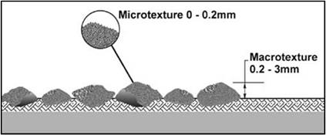
Macrotexture Measurements
Measurements – 0.5mm Intervals
Data Collected Since 2013
TAC Paper ➔ Initial Results of Texture Data
Released ➔ June 30, 2015
Notes:
MACROTEXTURE MEASUREMENTS
The LTPP program’s new pavement performance dataset is Surface Macrotexture

Measurements are being collected at 0.5mm intervals

The data has been collected since 2013

and all of the data is also scheduled to be released on JUNE 30, 2015
PAUSE
 - NEXT SLIDE

Slide 57
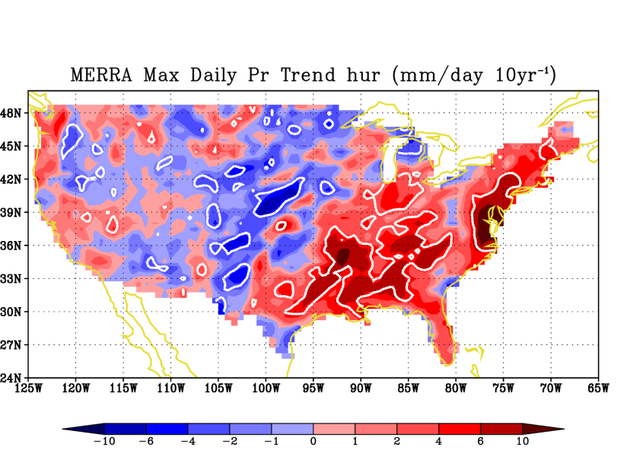
NASA MERRA Climate Data
Easy Access – InfoPave
Hourly Data for LTPP Test Sections
Elements Necessary for MEPDG Dataset
MERRA Data Extraction Tool ➔ PavementME
Released ➔ June 30, 2015
Notes:
NASA MERRA CLIMATE DATA
The LTPP program has migrated data from NASA’s MERRA program into InfoPave

Providing an easy access to

The climatic data that is relevant to the pavement community only

All of the data is also scheduled to be released on JUNE 30, 2015
PAUSE
 - NEXT SLIDE

Slide 58
LTPP Data Analysis Projects
PROJECT TITLE
Using LTPP Distress Data to Support Performance-Based Reporting
Characterizing Existing HMA Layer Damage for Mechanistic Pavement Rehabilitation Design
Increase in Roughness Due to Environmental Factors in Flexible Pavements
Advancement of Profile-Based Curl and Warp Analysis Using LTPP Profile Data
Incorporating a Curling Factor in Layer Moduli Backcalculation Using LTPP’s SMP FWD Data for Jointed Pavements
Validation of Pavement Performance Measures
LTPP Computed Parameter: Top-Down Cracking
Effect of Dowel Misalignment on Concrete Pavement Performance
Guidance to Facilitate the Analysts’ use of the LTPP Traffic Data, Including Estimating Traffic Loads
Predicting Truck and Axle Loading Patterns
Using Multi-Objective Optimization to Enhance Calibration of Performance Models in the ME-PDG
Pavement Performance Measures and Effects of Maintenance & Rehabilitation Strategy on Treatment Effectiveness
Update and Improve LTPP_Bind
Evaluation of Long-Term Pavement Performance Program Climatic Data for Use in Mechanistic-Empirical Pavement Design Guide Calibration and Other Pavement Analyses
Environmental Effects in the Absence of Heavy Loads, Specific Pavement Study 8
LTPP Ohio SPS-1 and 2 Dynamic Load Response Data Processing
Long-Term Pavement Performance Automated Faulting Measurement
Development of New Default Traffic Datasets for the M-E PDG Using the Data from LTPP SPS Traffic Data Collection Pooled-Fund Study, TPF-5
Verification, Refinement, and Applicability of Long-Term Pavement Performance Vehicle Classification Rules
Notes:
LTPP Data Analysis Projects
The LTPP program has many projects on the go

Here is a list of a few
PAUSE
 - NEXT SLIDE

Slide 59
Warm Mix Asphalt
Still Accepting Nominations
12 Approved Projects
2 Projects Constructed
10 Projects Constructed 2015/16
11 Highway Agencies
Notes:
WARM MIX ASPHALT
The LTPP programs most recent NEW Experiment is our SPS-10 – Warm Mix Asphalt Experiment, which examines asphalt mixes that include a technology that improves the production and placement of conventional asphalt mix at significantly lower temperatures

The LTPP program is still accepting project nominations to complete our experiment matrix

To date, 12 WMA projects have been approved

2 of which have already been constructed

And 10 others are expected to be constructed in 2015

The Experiment thus far involves 11 different Highway Agencies
PAUSE
 - NEXT SLIDE

Slide 60
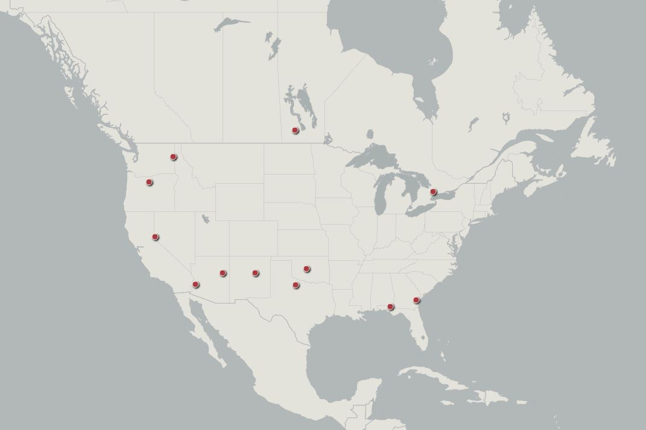
Project Locations
Arizona
Florida
Georgia
Manitoba
Nevada
New Mexico
Oklahoma
Ontario
Oregon
Texas
Washington
Notes:
LTPP WMA MAP
Here is and overview of our Warm Mix Experiment project locations

And these are the Highway Agencies currently involved in the Experiment
PAUSE
 - NEXT SLIDE

Slide 61

Cracking Data
MEPDG Inputs
Forensic Evaluations
new Experiment
Notes:
THE FUTURE
The LTPP program, recognizing that Research is a never ending process, is always looking to the future
Some future projects to expect from the program are:

Cracked Slabe Values

MEPDG Inputs

Forensic Evaluations

And another new pavement experiment
PAUSE
 - NEXT SLIDE

Slide 62


LTPP Cracking Data
Cracking Percentage and
Cracking Length
ALL LTPP Sections – AC, PCC & CRCP
HPMS / MEPDG / MAP-21 (NPRM) / Other
Release ➔ 2016
Notes:
CRACKED SLAB VALUES
Although the procedure has yet to be established and implanted, it is expected to include:

Measured Transverse Cracks, Count and % Slabs Cracked

Values for all LTPP Concrete Sections

For use with HPMS or MEPDG

It is anticipated the data will be released in 2016
PAUSE
 - NEXT SLIDE

Slide 63
Expansion of MEPDG Inputs
Currently GPS-3 & SPS-2 Sections Only
Expand to ALL LTPP Sections
Release ➔ 2016
Notes:
EXPANSION OF MEPDG INMUS&TTS
The LTPP Program expects to expand the availability of MEPDG Inputs on InfoPave

currently implemented for GPS-3 and SPS-2 sections only, we hope to

Expand to all LTPP Sections

It is anticipated the data will also be released in 2016
PAUSE
 - NEXT SLIDE

Slide 64

Forensic Evaluations
Transportation Pooled Fund Program
www.pooledfund.org
Solicitation Number: 1398
“
exactly why the section failed…
Notes:
FORENSIC EVALUATIONS – SLIDE 1
Solicitation for a new pooled fund through the


Transportation Pooled Fund Program has starting, led by the Washington State Department of Transportation

Solicitation Number 1398

The Objective is to Create a pooled fund to rapidly complete forensic evaluations of LTPP sections before going out of service, in order to determine EXACTLY why the sections failed
The pooled fund would pay the costs to perform the forensic evaluation in the field and limited lab testing from field samples

PAUSE
 - NEXT SLIDE

Slide 65

Forensic Studies
Coring
Trenching
Lift Deflection
Lab Testing
Notes:
FORENSIC EVALUATIONS – SLIDE 2
The Scope of Work is to Investigate LTPP test sections as they prepare to go out of service, capturing data on exactly why the section failed and had to be removed from service. This may entail:


Coring

Trenching

Measuring lift deflection

And potential lab testing of field samples for materials characteristics.
PAUSE
 - NEXT SLIDE

Slide 66
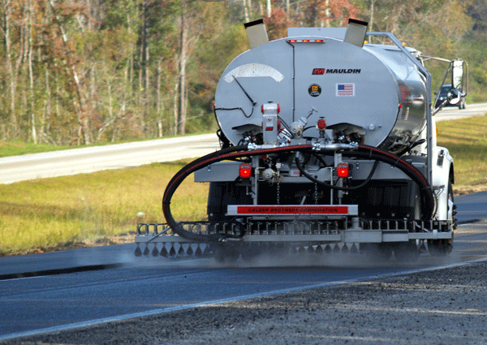
Tight Budgets
Preserve
High Volume
Pavement Preservation
Notes:
PAVEMENT PRESERVATION
State Highway Agencies are operating under much


tighter budgets

today than they were 20 years ago. To cope with the tighter budgets, more and more highway agencies are looking to Pavement Preservation as a way of

preserving their pavements while staying within their budgets. In addition we are seeing these treatments applied to a

higher volume of roads than in the past.
The LTPP program has recognized this trend and will be introducing a Pavement Preservation Experiment to evaluate different methods and technologies
PAUSE
 - NEXT SLIDE

Slide 67
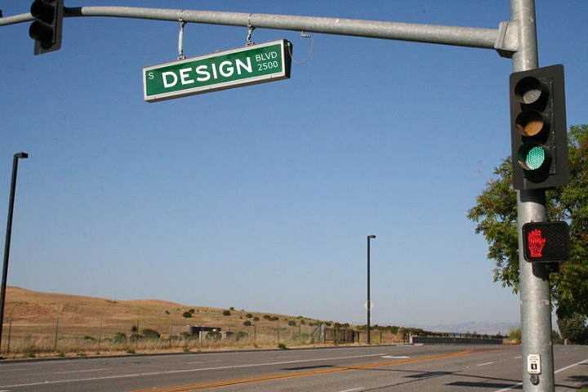
Experiment
“
When to use Specific Treatment
Pavement Condition
Structural Capacity
Treatment use based on Climate
Treatment use based on Traffic
Notes:
EXPERIMENT DESIGN
The experiment will include pavement preservation treatments for both flexible and rigid pavements and will focus on the treatments most frequently used by highway agencies. The following are possible items to be evaluated in the experiment:


When is it appropriate to use a specific treatment

Based on Pavement Condition

And Based on Structural capacity of the pavement

Is a treatment better suited for a particular climate zone

Is a treatment better suited for a particular traffic volume
The following are treatment types that may be considered:
PAUSE
 - NEXT SLIDE

Slide 68

Asphalt Pavements
Chip Seals
Slurry Seals
Micro Surfacing
Thin Overlays
Fog Seals
Notes:
ASPHALT PAVEMENTS
For Asphalt Pavements:

Chip Seals

Slurry Seals

Micro Surfacing

Thin Overlays

And Fog Seals – which Missouri is beginning to introduce fog sealing as a preservation treatment
PAUSE
 - NEXT SLIDE

Slide 69
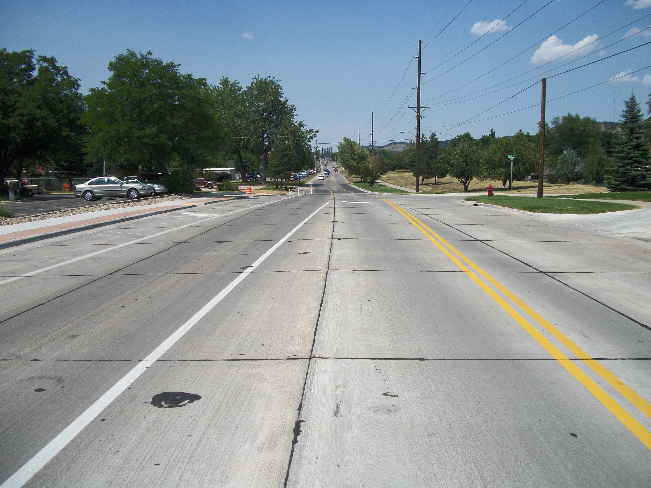
Portland Cement Pavements
Spall Repair
Partial Depth Patching
Grinding
Dowel Bar Retrofit
Joint Sealing
Surface Hardeners
Notes:
PORTLAND CEMENT PAVEMENTS
For Portland Cement Pavements:

Spall Repairs

Partial Depth Patching

Grinding

Dowel Bar Retrofit

And Joint Sealing
PAUSE
 - NEXT SLIDE

Slide 70
Pavement Preservation
Working on Experiment Design
Design Complete End of 2015
Accepting Nominations Early 2016
Notes:
PAVEMENT PRESERVATION - DETAILS
The LTPP program is

currently working on the Experiment Design

We anticipate the Design will be complete by the end of 2015

And the FHWA will be accepting test section nominations by early 2016
PAUSE
 - NEXT SLIDE

Slide 71

“
65% of Roads
in Less than
Good Condition
“
Population Grow by 70 Million
Make every Dollar Count!
Notes:
SAVE
The Beyond Traffic study recently completed by the US DOT, confirmed that America’s infrastructure is failing

Sixty-five percent of the roads are in “less than good condition”

The report also revealed that, over the next 30 years, Americans will ask more of our transportation system than ever before. The United States’ population will grow by 70 million.
The Grow America Act is intended to fund America’s infrastructure needs, to help address the failing system
But in the age of less funding and much greater need, it is up to the pavement research community to finds ways to

make every dollar count!
Although the transportation community cannot and should not expect LTPP to be the solution to all of its problems, the industry can rely on it as a preeminent source of pavement performance data
PAUSE
 - NEXT SLIDE

Slide 72

The Road Ahead
Data Collection
New Technologies
Full Performance Life
New Experiments
Data Analysis
Notes:
THE ROAD AHEAD
The road ahead is long and full of unknowns, and the decisions being made today will have a noticeable impact on that road
We can’t go back in time to collect field data, so it is essential we make field data collection a priority and an on-going effort, as we will need data now to answer all kinds of questions yet to be conceived in the future

Just as in every other industry, technology is a major factor in the pavement industry, and as new technologies become available, we must remain proactive to ensure we know and understand the long-term effects of these technologies

The LTPP program has many rehabilitated test sections capturing the “Full Performance Life” of these sections through continued monitoring will lead to a deeper understanding of the treatment option

With that said, we will also need NEW experiments, like our Warm Mix Asphalt and Pavement Preservation experiments, which will require State Agencies to participate by providing NEW test sections

We will also need to analyze the data from these NEW experiments, to evaluate their performance and provide insights in order to yield future savings
The LTPP program is an ongoing activity that will yield infinite benefits as long as data is being added to the database and new data analysis efforts are pursued
PAUSE
 - NEXT SLIDE

Slide 73
Academic Uses
Notes:
ACADEMIC USES
Some idea’s and examples of how students or professors can utilize LTPP program
PAUSE
 - NEXT SLIDE

Slide 74

“
The Possibilities are Endless…
Data for Specific Research
New Data Types for Research
Strategic Data Analysis Plan
Sample Case Studies
Sample Applications – InfoPave
Browse for Inspiration
Contact LTPP – for Anything Else!
Uses…and More
Notes:
USES…AND MORE
The possibilities are endless, whether you

Data for Specific Research

New Data Types for Research (Texture, Climatic, etc.)

LTPP Strategic Data Analysis Plan

Case Studies (on flash drive)

Sample Applications – on InfoPave

Browse for Inspiration

Contact LTPP – for anything else! Like collaboration…
PAUSE
 - NEXT SLIDE

Slide 75
ASCE Contest
Notes:
ASCE CONTEST
Contest…any interest in this topic???...
PAUSE
 - NEXT SLIDE

Slide 76



“
Encourage Students, Professors, Highway Agencies, and Consultants to use LTPP Data…
International Data Analysis Contest
Notes:
INTERNATIONAL DATA ANALYSIS CONTEST
The

LTPP program has once again teamed up with the

American Society of Civil Engineers (ASCE) , to bring you…
The 2015 LTPP International Data Analysis Contest
Initiated in 1998, the contest is designed to

encourage students, professors, highway agencies, and consultants from around the world to use the LTPP data
The contest offers a unique opportunity for contestants, primarily students, to work individually or in a team to perform research that will benefit the highway transportation community
PAUSE
 - NEXT SLIDE

Slide 77

Categories
Undergraduate Category: One to Four Undergraduate Students Only
Graduate Category: One to Four Graduate & Undergraduate Students
Partnership Category: Undergraduate
or Graduate Students Working with
Highway Agency or Private Company
Notes:
THEMES
This years contest theme is:

"Use of LTPP Data for Managing Pavement Assets"

This year’s contest also includes a challenge theme, the challenge theme is:

"Develop Pavement Health or Condition Indices Using LTPP Data"
PAUSE
 - NEXT SLIDE

Slide 78

Themes
Theme: Use of LTPP Data for
Managing Pavement Assets
Challenge Theme: Develop
Pavement Health or
Condition Indices Using
LTPP Data
Notes:
THEMES
This years contest theme is:

"Use of LTPP Data for Managing Pavement Assets"

This year’s contest also includes a challenge theme, the challenge theme is:

"Develop Pavement Health or Condition Indices Using LTPP Data"
PAUSE
 - NEXT SLIDE

Slide 79

Prizes
Cash Prize ($500 - $1500)
All-Expenses Paid to TRB
Published by FHWA
Award Certificate
Notes:
PRIZES
Authors of winning papers will receive a

cash prize, ranging from $500 to $1500, depending on the category

and an all-expense paid trip to Washington, D.C. to be nationally recognized at the 2016 Transportation Research Board (TRB) 95th Annual Meeting

In addition, winners will present their research topic at one or more of the TRB meeting sessions and will be given the option to have FHWA publish their winning paper, which will be available for researchers worldwide

All participants will receive a letter of recognition from ASCE and FHWA
PAUSE
 - NEXT SLIDE

Slide 80

Submission
Due By:
july 17th
www.InfoPave.com
Notes:
SUBMISSION
Submissions are

due by

July 17, 2015

For full contest details, please

visit the “Announcements” page on InfoPave
PAUSE
 - NEXT SLIDE

Slide 81
Feedback & Open Discussion
Notes:
FEEDBACK & OPEN DISCUSSION
Next we’ll examine the specific needs of the Delaware Department of Transportation
This is an open discussion and any feedback is greatly appreciated
PAUSE
 - NEXT SLIDE

Slide 82


Partnership
“
What is the Future of MUS&T and the LTPP Program?…
Notes:
PARTNERSHIP
It is extremely important to recognize that the LTPP program is a partnership


In this partnership the LTPP team manages the operations of the program, as described earlier
And the State Highway Agencies designate test sites, provide lane closures and provide test section data, such as traffic data and MNT/RHB data
Since State Highway Agencies are the primary users of the results garnered from the LTPP program, their involvement in the program is vital
What is the future of MUS&T and the LTPP program?
Involvement in NEW Experiments?
PAUSE
 - NEXT SLIDE

Slide 83
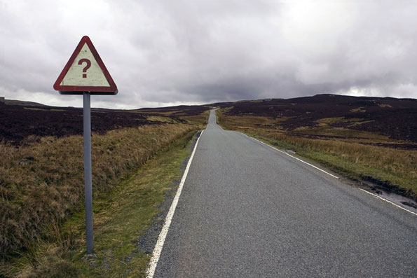
Utilization
“
How does MUS&T Currently Utilize LTPP InfoPave™, LTPP Data and LTPP Tools?…
Notes:
UTILIZATION
We’ll start off by asking,

How does MUS&T currently utilize LTPP InfoPave™, LTPP Data and LTPP Tools
If at all…If not, why not?
PAUSE
 - NEXT SLIDE

Slide 84

“
What does MUS&T Want From the LTPP Program?…
Ideas
Notes:
IDEAS
Next we ask,

What does MUS&T want from the LTPP program?
Are there any idea’s, suggestions…etc.
PAUSE
 - NEXT SLIDE

Slide 85
Conclusion
Notes:
CONCLUSION
That concludes our presentations today…
PAUSE
 - NEXT SLIDE

Slide 86
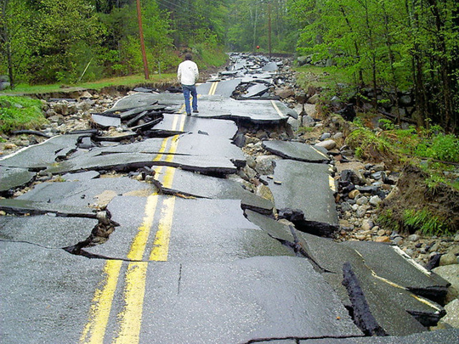
“
What happened?
...do you know?
Notes:
WHAT HAPPENED
As was previously mentioned; the program’s goal is to understand how and why pavements perform as they do

…so we don’t end up like this guy
Highway agencies have transitioned to a performance-based approach to managing their highway investments, thus this goal is more important than ever!
PAUSE
 - NEXT SLIDE

Slide 87

For Continued Support for Research
…Particularly
Notes:
THANK YOU
On behalf of the entire LTPP team…Thank you

for Continued Support for Research

…and particularly

the Long-Term Pavement Performance program
PAUSE
 - NEXT SLIDE

Slide 88

Questions

